Slide 1

The Foundation of Reform www.infrastructure.gov.au/roads/heavy/
Service Level Standards
Notes:
Hello, and welcome to the second module in a set of online presentations that aim to give you an outline of proposed Heavy Vehicle Road Reform.
These presentations supplement the information in the detailed consultation paper, available on the website shown here.
This second module deals with the foundational element of the proposed reforms – service level standards.
In November 2018, the Transport and Infrastructure Council agreed to develop service level standards for Australia’s roads.
Service levels will be designed in consultation with road users, and will include things road users experience and care about, such as safety, road condition, speed and reliability.
Service level standards are already used in other sectors, such as urban water, where standards for acceptable levels of quality, reliability and fairness in pricing are negotiated with users.
Service level frameworks are already used by road managers in most states and territories in Australia. But the categorisation of roads differs across those jurisdictions, and there is no single harmonised standard for what road users should expect on different roads.

Slide 2
National service level standards (SLS) aim to deliver:
A system that is more open and responsive to user preferences
A tool to help governments improve their road investment decision-making
National consistency in reporting road service delivery
A yardstick to determine what costs can be passed on to heavy vehicles through national charges
Notes:
National service level standards aim to deliver:
A system that is more open and responsive to user preferences—a systematic framework to capture road user preferences and use them to inform road funding and investment decisions.
A tool to help governments improve their road investment decision-making, by providing a national and complete understanding of user wants and needs from different types of road across the road network. This will include new sets of data consistently reported across the country.
National consistency in reporting road service delivery – which will support informed discussions with road users on what they are paying for.
A yardstick, or common language, through which to determine what costs can be passed on to heavy vehicles through national charges.

Slide 3
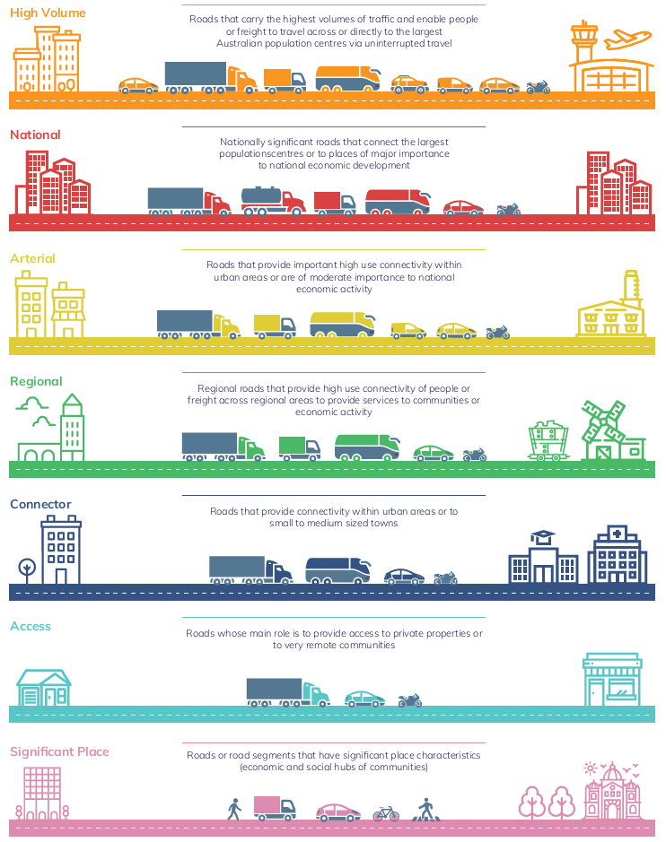
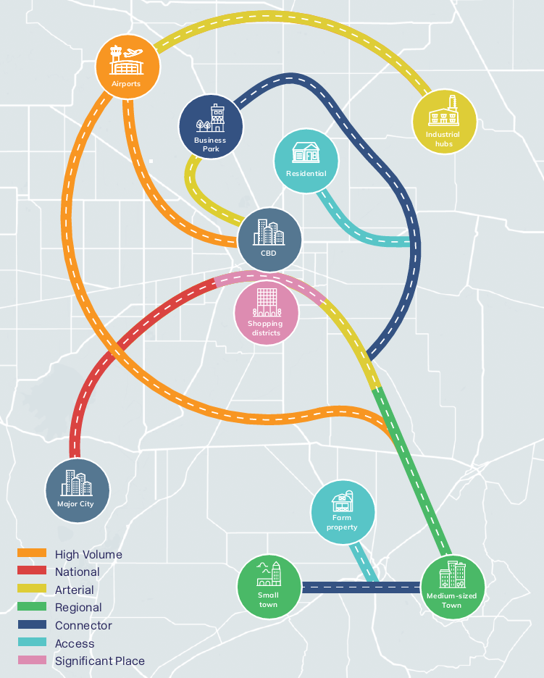
How would SLS apply to roads?
Notes:
Service level standards would focus on things road users care about, like safety, amenity, access and reliability.
There would be a range of expected service for each of these things, for different types of roads.
The SLS framework will not mandate a minimum standard for roads. It will instead describe levels of service that users can expect to be delivered, over time.
For major urban freeways, the standards might capture that users expect a road with high reliability, separated traffic, multiple lanes, intersection lighting etc.
For roads connecting two small rural towns, the standards could reflect that it wouldn’t be feasible to provide (and users wouldn’t want to pay for) all the things freeways have. Instead, the main things users might expect might be regular opportunities to pull over, bridge upgrades to allow heavy vehicle access, clear signage and safe corners.
The graphics on this slide set out some early draft categories of road that are being used in further consultation in 2020.

Slide 4
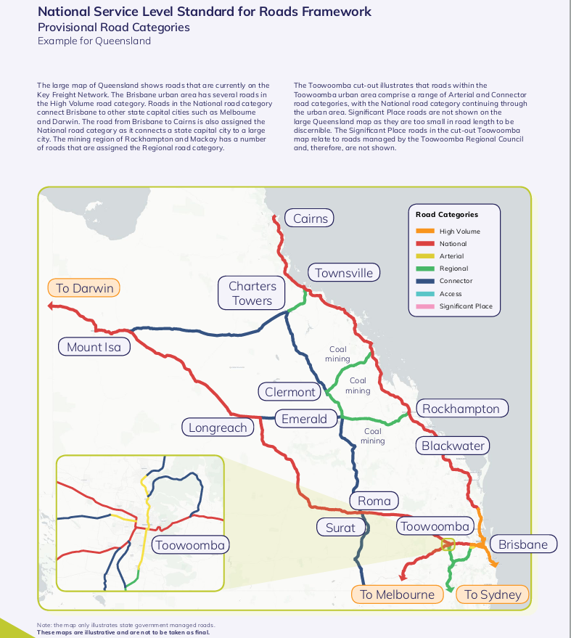
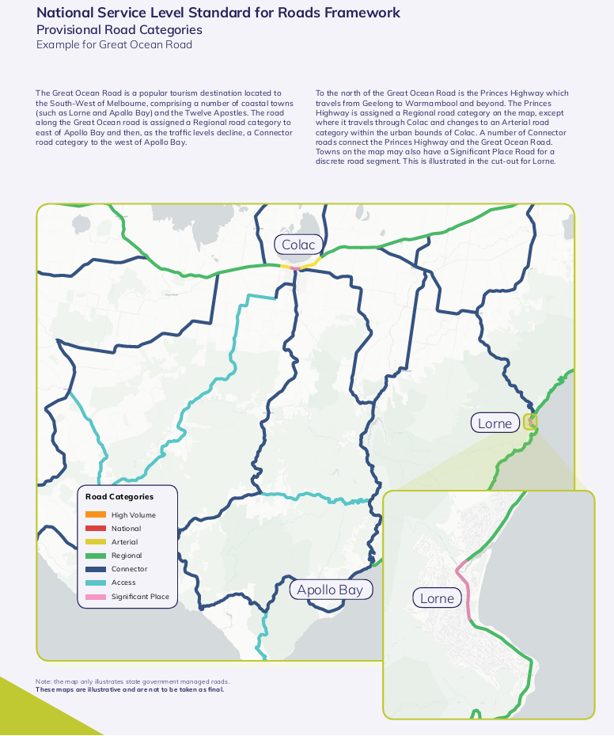
How would SLS apply to roads?
Notes:
The service level standards would aim to capture these preferences of road users, and differences across road categories, in a systematic and nationally consistent way.
The standards would set out ranges of service levels, partly to allow for differences across different parts of Australia.
The graphics on this slide provide two draft examples of how levels of service may differ across the different roads in a region.

Slide 5
The SLS Framework is being developed through a phased approach:
Phase 1 –Principles to guide the development of a nationally consistent SLS Framework
Phase 2 – Development of a prototype of a nationally consistent SLS Framework
Phase 3 – Testing of the prototype SLS Framework and development of performance measures
Phase 4 – Early implementation of the SLS Framework by state governments
Notes:
The Service Level Standard Framework for Roads (SLS Framework) is being developed by jurisdictions through a phased approach as follows:
Phase 1 was the drafting of principles to guide the development of a nationally consistent SLS Framework (completed in December 2018).
Phase 2 saw the development of prototype road categories and customer service aspects (competed in December 2019).
Phase 3 will involve further testing and refinement of the prototype framework, including the development of performance measures. This Phase 3 week has just started and will run until the first half of 2021.
Phase 4 will be the early implementation of the SLS Framework by state governments, subject to agreement by governments to proceed.
So it is still early days in the development and application of national service level standards for roads.

Slide 6
User input to SLS
Consultations on finer details will commence later in the year
User input necessary to ensure SLS reflect user needs and willingness to pay
Transport and Infrastructure Council likely to review and update SLS periodically
Notes:
The standards will be developed in consultation with road users.
Consultations with users on Phase 3 – the testing and refinement of the prototype categories and service levels – is planed for September-October in 2020.
User input to the service level standards is important, to ensuring the standards reflect user preferences and priorities. If service levels are set too high, users could pay for services they do not want. If service levels are too low, this could lead to the deterioration of the road network.
It is likely the Transport and Infrastructure Council will look at and update the service level standards every few years.
There are potentially different ways to capture the views of users in these processes. One option would be to hold full public consultation on the standards. Alternatively, a consultative user-group could be convened each time the standards are to be reviewed, to provide a formal mechanism for input. Or a standing user-input group could be established, to advise governments continuously. We are interested in your views on the pros and cons of these options.

Slide 7
Questions to consider
What advantages/disadvantages do you see in applying SLS to road investment planning?
How can a representative range of all road user groups (including heavy vehicles) provide input into setting and reviewing SLSs?
Interested in being consulted? Contact HVRR@infrastructure.gov.au for details of consultation workshops.
Notes:
These are some of the questions, in relation to service level standards, that we want to explore in this public consultation on Heavy Vehicle Road Reform.
If you are interested in being consulted – either on service levels in particular, or on road reform more broadly – get in touch with us through the email address shown here. We can give you details of planned consultation workshops.

