Slide 1
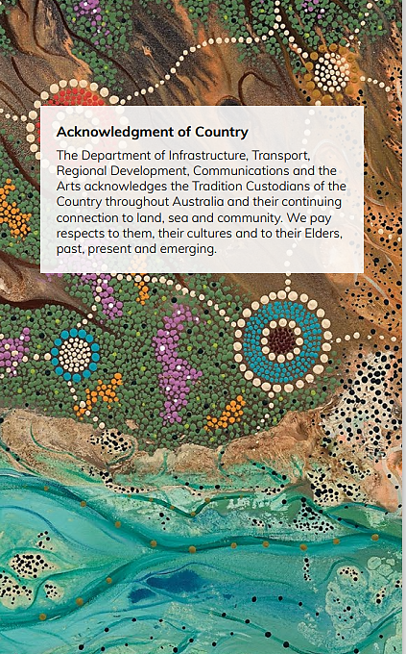
Australia’s Maritime Context and Emission Reduction Initiatives
September 2023
MERNAP@infrastructure.gov.au
These slides provide some background of Australia’s maritime context and clean energy developments. They are not comprehensive and do not seek to shape the outcome of the Maritime Emissions Reduction National Action Plan (MERNAP) development process.

Slide 2
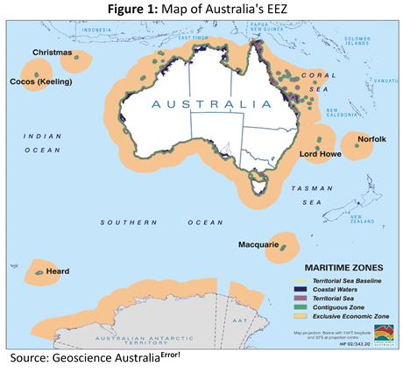
Australia’s Maritime Context
Australia’s Exclusive Economic Zones (up to 200 nautical miles from the territorial sea baseline)
Australia’s Key Ports
Ports play a central role in the nation’s economy, trade and supply chains. The map below shows Australia’s principal ports by main commodity. Iron ore and liquefied natural gas (LNG) are mainly exported from west coast ports, coal from east coast ports and containerised merchandise mainly from capital city ports.
Australia has one of the largest EEZs in the world, around 10 million square kilometres - 8.2 square kilometres are located off Australia and its remote offshore territories, and 2 million square kilometres off the Australian Antarctic Territory.
Oceans and Seas | Geoscience Australia (ga.gov.au)
Source: BITRE, Australian Infrastructure and Transport Statistics Yearbook 2022, Figure 19, p.184

Slide 3
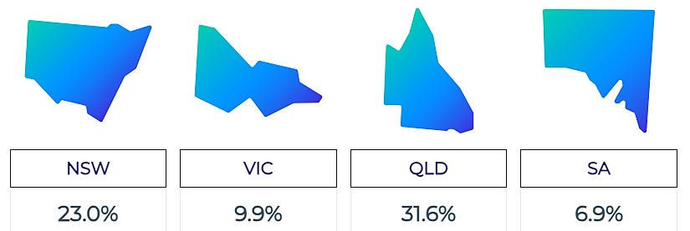
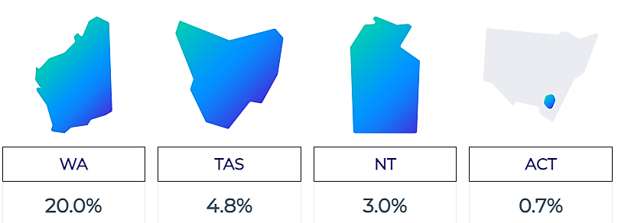
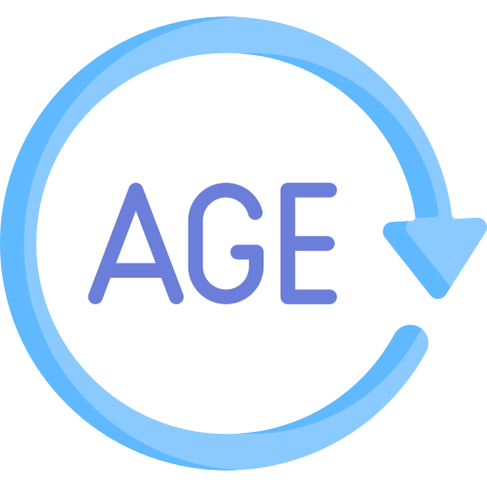
Australia’s Maritime Workforce
Main Industries
Marine Transport Professionals
(Feb 2023):
9,500 Employed
Transport, Postal & Warehousing
59.8%
Agriculture, Forestry & Fishing
9.2%
Manufacturing
6.9%
Public Administration & Safety
6.9%
Other industries
16.1%
5% Female
Employment across Australia
1% Aboriginal and Torres Strait Islander
Average Age 46
Weekly Earnings $2,998
Around 57% of marine transport professionals live outside of capital cities, compared with the all jobs average of 38%.
A large share of maritime workers are aged 45 to 54 years, with a median age of 46 years - higher than the all jobs average of 40 years.
~12,700 workers by 2026
Median full-time earnings are $2,998 per week - much higher than the all jobs median of $1,593.
Marine Transport Professionals | Labour Market Insights

Slide 4
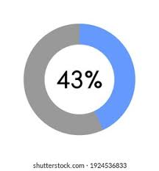
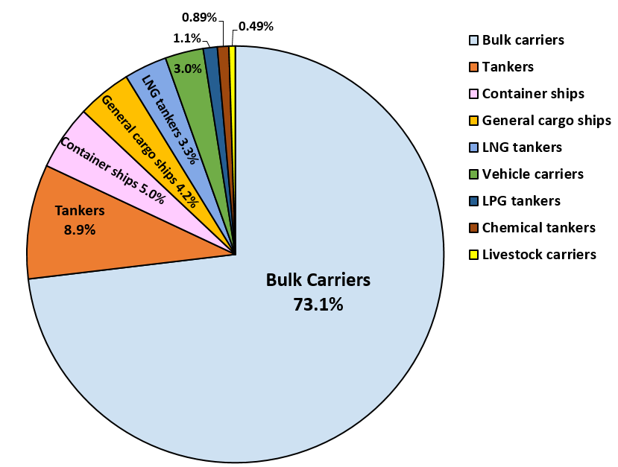
Australia’s Seaborne Trade
Ships transport over 99% by weight and around 87% by value of Australia’s international trade.
Top 3 Exports 2019-20
Minerals and fuels contributed $245.8 billion or 51.7% of Australia’s total exports by value, with iron ore, coal and natural gas being the top 3 commodities.
Tonnes of goods transported by sea 2020-21
1,613.2 million tonnes
1,516.1 million tonnes in Exports
97.1 million tonnes in Imports
Iron Ores and Concentrates
21.6%
Coal
11.5%
Natural Gas
10.0%
of Australia’s total exports by value
Trade and Investment at a glance 2021 (dfat.gov.au)
Top 5 ports visited by overseas cargo ships 2020-21
Cargo Ships 2020-21
1
2
3
5
4
Port Hedland
Newcastle
Gladstone
Hay Point
Dampier
6,315 uniquely identified cargo ships visited at least one Australian port
30,613 calls to Australian ports
Nearly three quarters of cargo ships visiting Australian ports in 2020-21 were bulk carriers.
Over 98% of cargo ships arrived from overseas
Australian Infrastructure and Transport Statistics - Yearbook 2022 (bitre.gov.au)
Australian Sea Freight 2020-21.pdf (bitre.gov.au)

Slide 5
Australia’s Trading Fleet 2020-2021
Defined as cargo ships greater than 150 gross tonnage owned or operated by Australian companies, that carried cargo or both cargo and passengers, but excluding ships carrying passengers only.
Flag status
137 Vessels
Minor Trading fleet (<2000 DWT)
Major Trading fleet (>=2000 DWT)
39 Bulk Carriers
9 Container Carriers
51 General cargo ships
6 Livestock Carriers
14 LNG Tankers
5 LPG Tankers
36 Australian Flagged
20 Australian Flagged
(4 in international trading and
16 in coastal trading)
11 Tankers
2 Vehicle Carriers
5 Foreign Flagged
76 Foreign Flagged
(54 in international trading and
22 in coastal trading)
Ship Age (years) | 0-4 | 5-9 | 10-14 | 15-19 | 20+
Number of ships | 19 | 33 | 38 | 18 | 29
Average age of ships = 13.5 years
Australian Sea Freight 2020-21.pdf (bitre.gov.au)

Slide 6
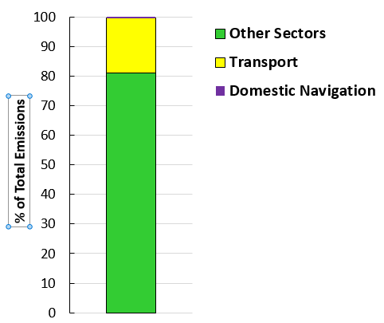
Australia’s Domestic Greenhouse Gas Emissions 2021-22
Australia’s Total GHG Emissions
486.9 Mt CO₂-e
Transport Sector Emissions
90.7 Mt CO₂-e (18.6% of total emissions)
Domestic Navigation Emissions
2 Mt CO₂-e (2.2% of transport emissions and 0.4% of total emissions)
National Greenhouse Gas Inventory Quarterly Update: June 2022 - DCCEEW

Slide 7
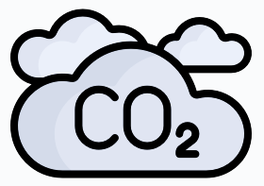
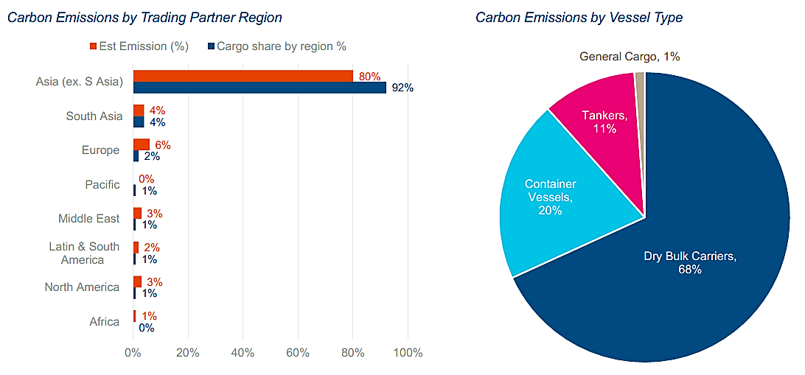
Australia’s GHG Emissions from International Trade 2020
1.49 billion tonnes
14% of global seaborne trade
39.2 million tonnes of CO₂
4% of global shipping CO₂ emissions
Australia’s share of global sea freight is 14%, but ships carrying our sea freight (irrespective of flag) contribute a lower share of 4% of global CO₂ emissions from international shipping.
The lower emissions on average is because:
a majority of Australia’s trade commodities is dry bulk cargo, and large bulk carriers are generally more fuel/energy efficient compared to other vessel types
the relatively short sailing distances between Australia and its main trading partners – 92% of Australia’s trade is with Asia (excluding South Asia).
emitted
Most of Australia’s trade is with North and East Asia (around 92% by tonnage) which generated 31.5 million tonnes of CO₂ or 80% of Australia’s total international trade emissions in 2020.
Dry bulk carriers carried 91% of Australia’s trade volume and emitted 26.7 million tonnes of CO₂ or 68% of Australia’s total international trade emissions in 2020.
BMT Defence and Security Australia Pty Ltd, Economic Analysis of Global Shipping Carbon Price Impacts on Australia’s International Shipping Costs and Maritime-Dependent Trade, March 2022, commissioned by DITRDCA (unpublished).

Slide 8
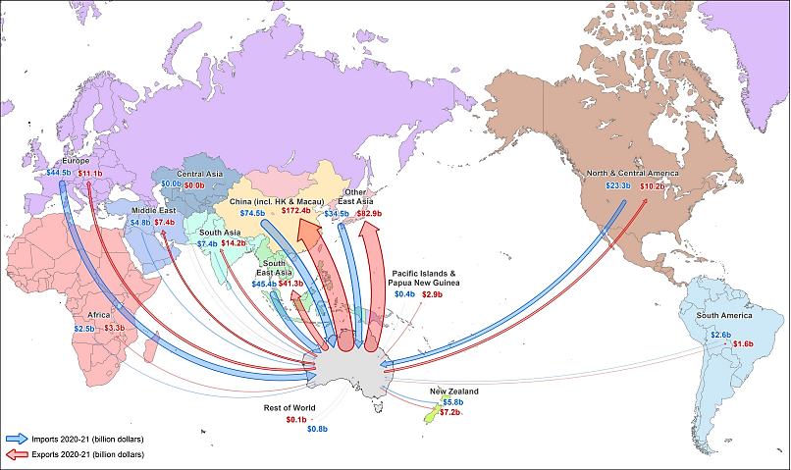
Value of Australia's international sea freight by final destination or origin, 2020-21
Australian Sea Freight 2020-21.pdf (bitre.gov.au) Figure 1.3, page 7

Slide 9
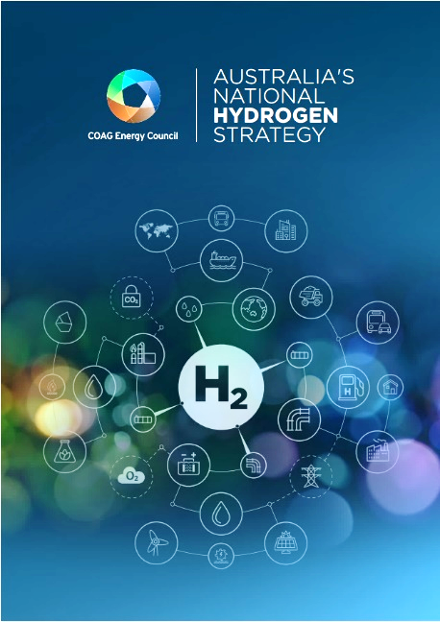
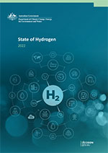
National Hydrogen Strategy
Australia’s Hydrogen Initiatives
Australia can help reduce global shipping emissions by supplying sustainable low and zero carbon marine fuels, including green hydrogen and its derivatives.
State of Hydrogen Report 2022
Released 2019, but currently under review.
Aims to:
build a clean, innovative, safe and competitive hydrogen industry
position Australia has a renewable energy superpower.
Priority stretch goal $2 per kilogram of green hydrogen.
Under the National Hydrogen Strategy, the Australian Government undertakes an annual review of Australia’s clean hydrogen industry development and publishes an annual State of Hydrogen report.
The Report tracks:
progress on developing Australia’s hydrogen industry
what governments around Australia and the private sector are doing to advance the industry.
$230-300 billion pipeline of announced or potential hydrogen investment in Australia, with over 100 hydrogen projects.
Australia’s National Hydrogen Strategy - DCCEEW
Growing Australia's hydrogen industry - DCCEEW
State of Hydrogen 2022 - DCCEEW

Slide 10
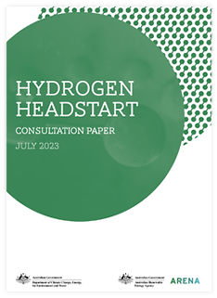
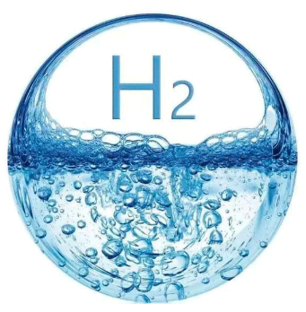
Hydrogen Headstart
Announced in the 2023-2024 Federal budget - $2 billion support for large-scale renewable hydrogen projects through competitive hydrogen production contracts.
Intended to bridge the commercial gap for early projects and establish up to a gigawatt of electrolyser capacity by 2030.
ARENA and DCCEEW have published a consultation paper outlining program specifications, including objectives, eligibility criteria and funding mechanism.
Expressions of interest expected to be open Qtr1, 2024.
Following assessment, successful projects will receive a production credit over a 10-year period to cover the price gap between the cost of producing green hydrogen and the sale price of that hydrogen or its derivative products.
Hydrogen Headstart program - DCCEEW
Hydrogen Headstart - Australian Renewable Energy Agency (ARENA)
HyResource
Further information on projects to develop hydrogen and its derivatives in Australia is available at HyResource.
The website includes a downloadable dataset of Australian hydrogen-related projects, recent project updates, a hydrogen mapping tool and information on government funding support.
HyResource (csiro.au)

Slide 11
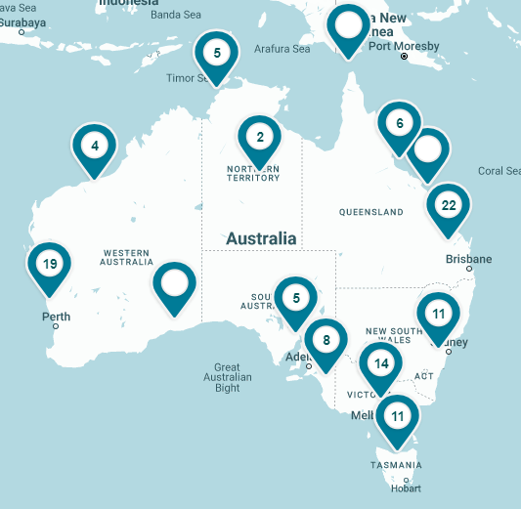
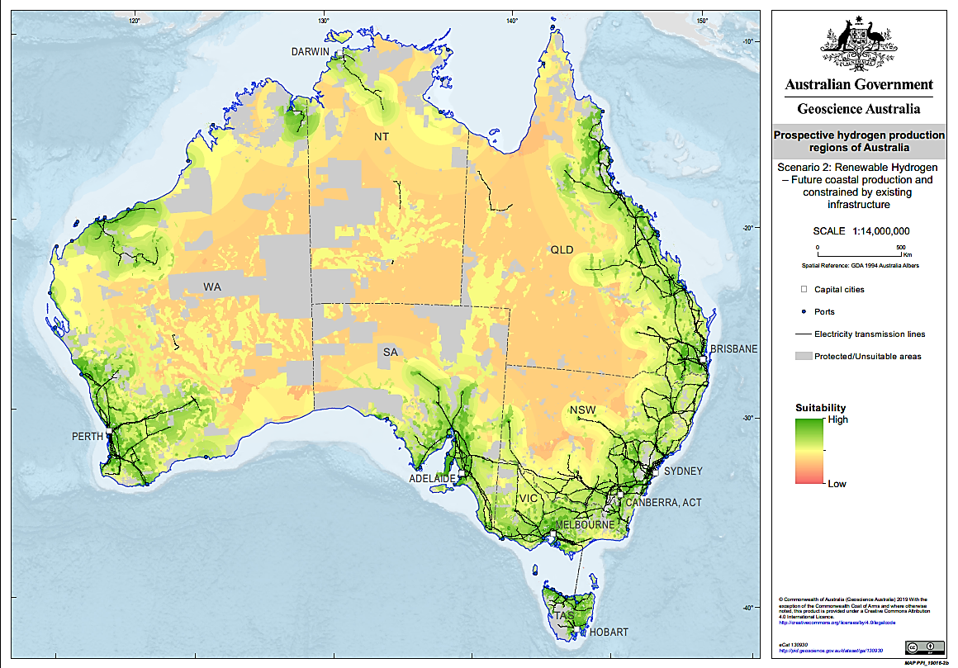
Hydrogen Project Mapping Tools
Geoscience Australia:
Map of prospective hydrogen production regions of Australia. Hydrogen production regions in Australia – DCCEEW
Hydrogen Economic Fairways Tool (HEFT): an online mapping tool that identifies regions suitable for hydrogen production in Australia. HEFT - Hydrogen Economic Fairways Tool (ga.gov.au)
CSIRO:
HyResource: provides spatial representation of the projects across Australia as well as filtering capability by status, main end use, and main proponents Hydrogen Map - CSIRO

Slide 12
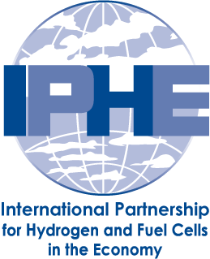
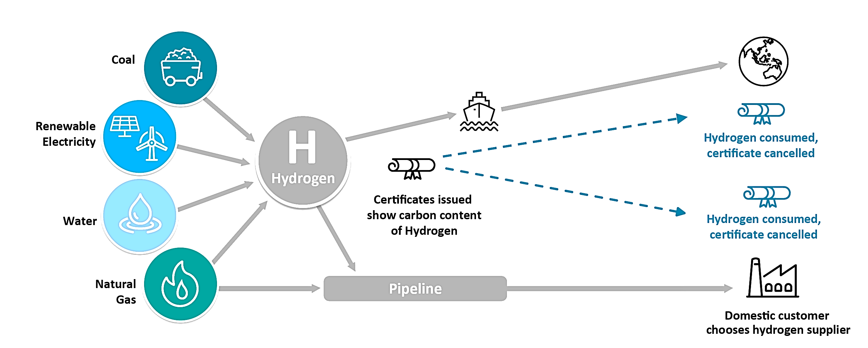
Hydrogen Regulatory Frameworks under development
Hydrogen Guarantee of Origin (GO) Scheme
The National Hydrogen Strategy identifies the establishment of a domestic hydrogen GO certification scheme as a priority action to track and certify the origins of locally-produced hydrogen.
The GO scheme will measure and track hydrogen production emissions from initially three main pathways relevant to Australia: electrolysis, coal gasification with carbon capture and storage (CCS), and steam methane reforming of natural gas with CCS.
The 2022-23 Budget provided DCCEEW with $2.2 million to develop and consult on the design and draft legislation for a GO scheme. In December 2022, DCCEEW released 2 consultation papers on the design of the GO and renewable electricity certification, with public consultation closing in February 2023.
The Clean Energy Regulator (CER) has been conducting trials throughout 2022 and 2023 to test and verify the GO scheme design with producers of hydrogen and its derivatives, as well as stakeholders involved in the storage and transport of these products.
In the 2023-24 Budget, a further $38.2 million was provided to create the GO scheme.
An international governmental partnership formed in 2003 and currently consisting of 23 member countries and the European Commission.
Aims to advance technical hydrogen industry standards and protocols, including safety standards, regulation development, certification, trading, intellectual property and education.
Australia leads on the development of carbon accounting methodology for electrolysis and coal gasification with CCS.
Australia’s GO scheme draws on the IPHE’s work to ensure we meet our international partners’ needs and requirements as importers of Australia’s clean energy.
Guarantee of Origin scheme - DCCEEW
Guarantee of Origin (cleanenergyregulator.gov.au)
International Partnership for Hydrogen&Fuel Cells in the Economy (iphe.net)

Slide 13
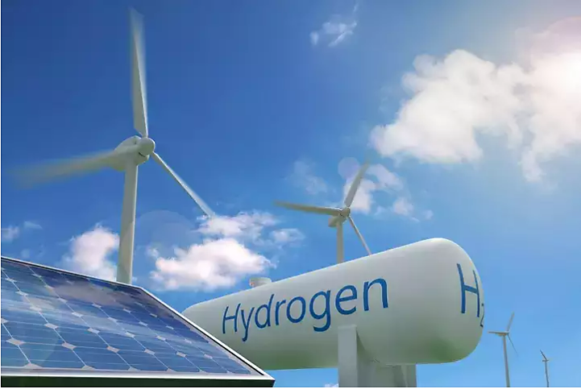
Hydrogen Hubs
Australian Federal, State and Territory governments support the hub model to scale up hydrogen production. Hydrogen hubs co-locate producers, exporters and users across industrial, transport and energy markets, which helps to reduce production and distribution costs. Hubs near ports have been chosen for development due to ready access for export and bunkering opportunities.
Australian governments are investing over $1 billion in hydrogen hubs:
Jurisdiction | Financial support | Details
NSW | $150m | Hubs focused on Illawarra and Hunter regions
QLD | $15m | Part of the QLD Government’s $4.5b Renewable Energy and Hydrogen Jobs Fund. To progress FEED study for the Stanwell consortium CG-H2 project.
SA | $67m | $37m to upgrade Port Bonython jetty. $30m to develop the Port Bonython Hydrogen Hub.
TAS | $230m | Tasmanian Green Hydrogen Hub at Bell Bay.
WA | $124.5m | Pilbara Hydrogen Hub, Oakajee Strategic Industrial Area & H2 Kwinana project
COMMONWEALTH | $526m | 8 hubs close to ports under the Regional Hydrogen Hubs’ program
The 2022-23 federal budget also included the following funding allocations relevant to regional hydrogen hubs development:
$1.5 billion for a common user marine infrastructure within the Middle Arm Sustainable Development Precinct at Darwin to further develop export opportunities in Northern Australia for commodities such as green hydrogen and critical minerals.
$565 million in enabling infrastructure in the Pilbara region to support emerging green industries and technologies.
$100 million to support the Port of Newcastle and the Hunter region become hydrogen-ready.
State of Hydrogen 2022 - DCCEEW
Regional Hydrogen Hubs Program (Transferred to Hubs Webpage) – HyResource (csiro.au)

Slide 14
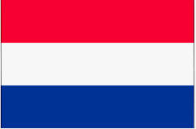
Australia’s International Partnerships on Low Emission Technologies
The Australian Government is working closely with international partners to advance practical action on climate change and build new clean energy industries, particularly for green hydrogen and its derivatives.
Australia – Germany Hydrogen Accord: Australia and Germany are committing $50 each to deliver the German-Australian Hydrogen Innovation and Technology Incubator (HyGATE) to support real-world projects along the hydrogen supply chain.
Australia – United Kingdom Partnership on Low Emissions Solutions: Collaboration on making low emissions technologies commercially viable, with a focus on clean hydrogen, CCUS, small modular reactors, low emissions material like green steel and soil carbon measurement.
Australia – Japan Partnership on Decarbonisation through Technology: Advancing cooperation in clean hydrogen and ammonia, carbon capture, use and storage (CCUS), and low emissions steel and iron ore, including strong cooperation through the Hydrogen Energy Supply Chain (HESC) project.
Australia – Singapore Initiative on Low Emission Technologies for Maritime and Port Operations: $30 million initiative to accelerate the deployment of clean hydrogen and ammonia fuels and technologies specifically in maritime and port operations.
Australia – Republic of Korea Low and Zero Emissions Technology Partnership: Collaboration across low and zero emissions technologies, including clean hydrogen and ammonia supply, hydrogen power generation, hydrogen fuel cell electric vehicles, CCUS and low emissions steel and iron ore.
Australia – India Low Emissions Technology Partnership: Australia and India have committed to working together to reduce the cost of clean hydrogen and solar technologies, including through an Australia-India Green Hydrogen Taskforce.
Australia-United States Net Zero Technology Acceleration Partnership: Practical cooperation on energy storage, digital electricity grids, hydrogen and CO₂ removal, including direct air capture.
Australia-Netherlands Memorandum of Understanding on Cooperation in the Field of Hydrogen: To develop a renewable hydrogen supply chain from Australia to Europe covering hydrogen trade policy, regulations, port infrastructure and supply chain, and hydrogen technologies, including for shipping.
State governments are also building international partnerships to support specific clean energy projects in their jurisdictions, for example
March 2021: South Australia signed an MoU to investigate clean hydrogen exports with the Port of Rotterdam in the Netherlands.
November 2021: Western Australia signed an MoU with the Port of Rotterdam to collaborate on developing a clean hydrogen supply chain from Western Australia to the port.
Australia’s international clean energy partnerships - DCCEEW

Slide 15
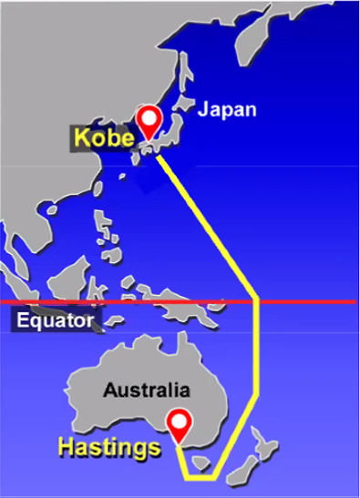
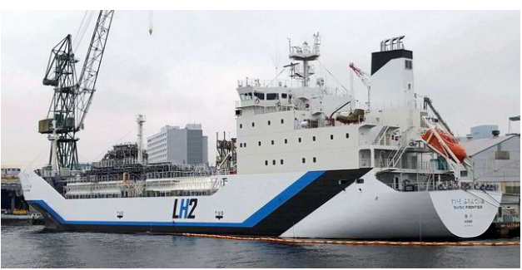
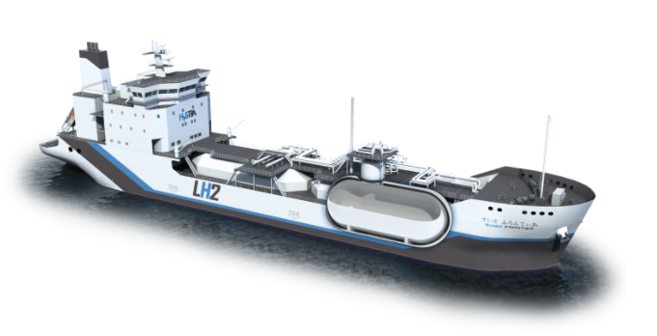
Case Study - Hydrogen Energy Supply Chain (HESC)
The project aims to safely produce and transport liquid hydrogen (LH2) from Australia’s Latrobe Valley in Victoria to Kobe in Japan.
$500 million collaboration between Australia (Commonwealth and Victoria) and Japanese governments and industry partners to ship liquefied hydrogen between Australia and Japan.
In February 2022, the first LH2 shipment from Port of Hastings arrived safely in Kobe on the Suiso Frontier – the world’s first liquid hydrogen carrier built by Kawasaki Heavy Industries.
The pilot project demonstrated a complete hydrogen supply chain by:
gasifying brown coal from Latrobe Valley, Victoria, to produce hydrogen gas
trucking the gaseous hydrogen to the Port of Hastings, Victoria, for conversion into liquid hydrogen (LH2) and export
shipping the LH2 to the Port of Kobe, Japan.
In the commercial phase, around 225,000 tonnes of clean LH2 is expected to be produced from the Latrobe Valley brown coal with carbon capture and storage (CCS). This amount of LH2 is expected to reduce global carbon dioxide emissions by 1.8 million tonnes per year (equivalent to emissions from around 350,000 petrol-driven cars).
Suiso Frontier
The CarbonNet Project, jointly funded by the Australian and Victorian Governments, is investigating the development of a commercial-scale CCS network from the Latrobe Valley to offshore carbon storage sites in the Gippsland Basin in Bass Strait.
LH2 tank (1,250m³)
Image source: HESC Project
CarbonNet | Department of Jobs, Skills, Industry and Regions (djsir.vic.gov.au)
HESC (hydrogenenergysupplychain.com)

Slide 16
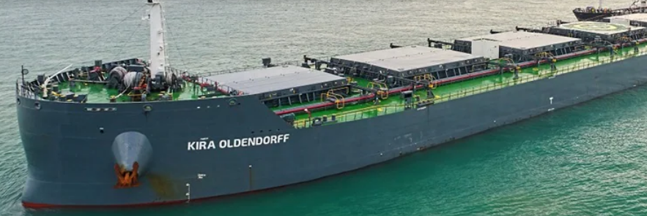
Green Shipping Corridors
CLYDEBANK DECLARATION to boost green shipping
Energy-port-shipping partnerships are essential for maritime decarbonisation.
Green shipping corridors (GSCs) are practical collaborative mechanisms to demonstrate low and zero emission vessels and fuel supply chains − accelerating their uptake.
Flow on benefits (e.g. technology transfer, upskilling, business opportunities) to the domestic maritime sector.
Australian Government engaged in several international GSC initiatives, including:
COP26 Clydebank Declaration (24 signatories) - at least 6 GSCs by 2025
Quad Shipping Taskforce – 2 to 3 GSCs in the Indo-Pacific by 2030
Singapore-Australia Green Economy Agreement – green and digital shipping cooperation
Mission Innovation: Zero Emission Shipping Mission – aims to enable at least 5% of the global deep-sea fleet to run on zero emission fuels by 2030
Australia & New Zealand Green Corridors Pre-Feasibility Assessment led by the Mærsk Mc‑Kinney Møller Center for Zero Carbon Shipping
Government looking for further strategic partners to directly collaborate on GSCs – to be guided by the MERNAP.

Slide 17
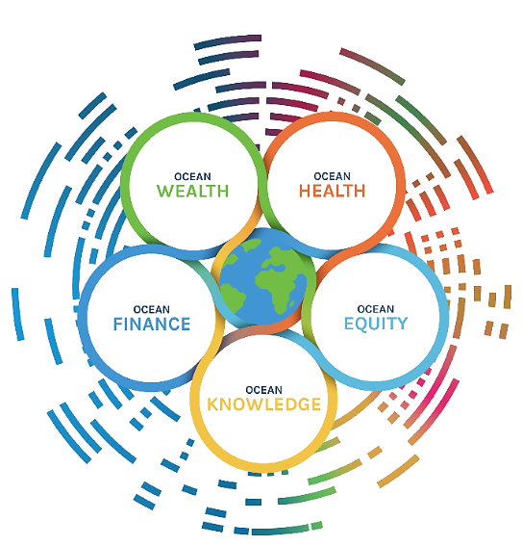
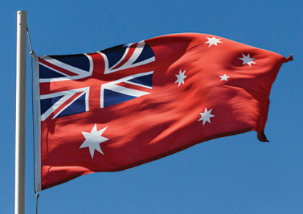
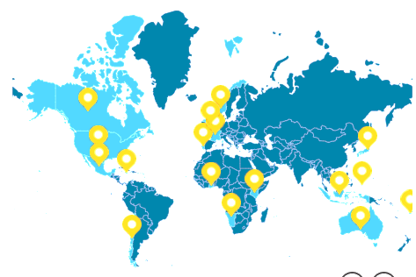
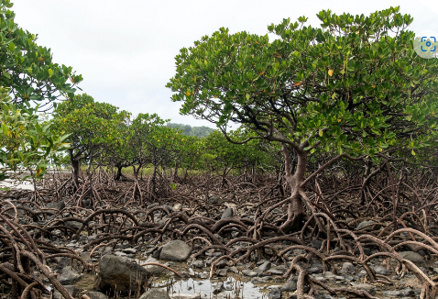
Sustainable Ocean Economy
Other Australian Government Initiatives
Maritime Single Window
As a signatory to the Convention on Facilitation of International Maritime Traffic 1965 as amended (the FAL Convention), Australia has an international obligation to establish, maintain and use a Maritime Single Window (MSW) to facilitate the exchange of electronic shipping data.
Growth in emerging ocean sectors, such as offshore energy and aquaculture, offers huge potential to support Australia’s transition to renewable energy sources. It also supports ocean-based solutions to climate change.
The Government is developing a one-stop digital reporting portal to allow ships to electronically submit all information in connection to the arrival, stay and departure of a ship in Australian ports.
The MSW will be interoperable with Australia’s Trade Single Window, also under development.
A more streamlined data exchange process will contribute to maritime decarbonisation by reducing ship turnaround time and port congestion, as well as potentially facilitating just-in-time arrivals for optimal vessel passage planning to Australian ports.
Australia is a member of the High Level Panel for a Sustainable Ocean Economy (Ocean Panel) with 16 other coastal nations .
Established in 2018, the Ocean Panel commits to sustainably manage 100% of the ocean area within national waters, guided by national Sustainable Ocean Plans developed by 2025.
The Ocean Panel supports the ’30 by 30’ target to protect at least 30% of the global ocean as marine protected areas and other effective conservation areas by 2030.
The Australian Government is developing our Sustainable Ocean Plan to identify a long-term vision for our ocean and a roadmap of policies and programs needed to deliver that vision.
Maritime Strategic Fleet
The Australian Government is committed to establishing a Maritime Strategic Fleet of Australian flagged and crewed vessels to strengthen our economic sovereignty and improve national security.
A Strategic Fleet could provide broader benefits, including contributing to other Government priorities, such as reducing maritime transport emissions and creating demand for low and zero carbon marine fuels.
The Strategic Fleet Taskforce submitted its final report to Government on 30 June 2023 for consideration.
Aims for 100% sustainably managed oceans
Maritime Strategic Fleet Taskforce | DITRDCA
Ocean Panel

Slide 18
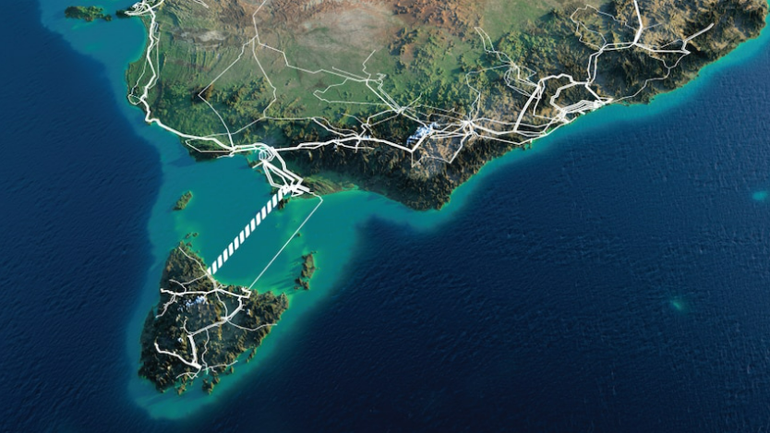
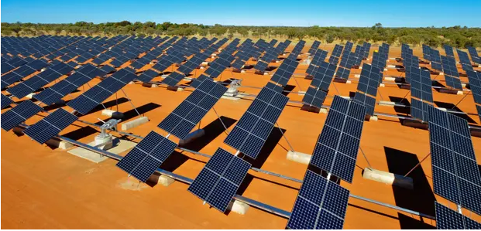
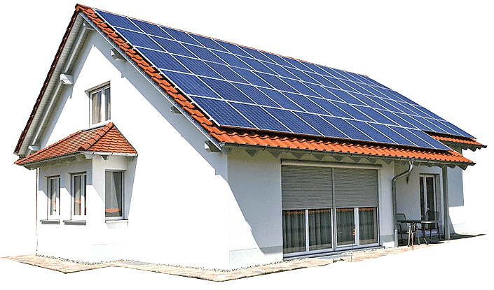
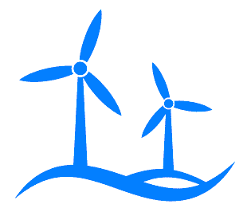
Powering Australia to deliver a cleaner energy future
To back its commitment to net zero emissions by 2050, the Australian Government’s Powering Australia Plan aims to:
decarbonise the industry, power and transport sectors
ensure energy security and affordability
create new jobs.
The Government has committed A$25 billion to clean energy projects, including
A$20 billion Rewiring the Nation plan to modernise Australia’s electricity grid and infrastructure
A$1.9 billion Powering the Regions Fund to decarbonise existing industries, develop new clean energy industries and build Australia’s new energy workforce in Australia’s regions
A$500 million Driving the Nation Fund to help reduce road transport emissions
A$300 million for community batteries and solar banks
A$100 million to the New Energy Apprenticeships and New Energy Skills programs
Powering Australia | energy.gov.au

Slide 19
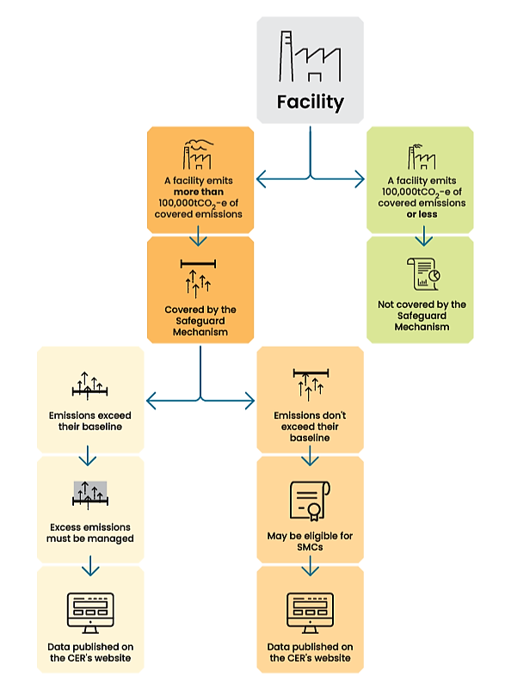
Safeguard Mechanism
2021-22 Reporting Year
In place since 1 July 2016, it aims to cut greenhouse gas emissions from Australia’s large industrial facilities (emitting more than 100,000 tonnes of CO₂-e per year).
Safeguard facilities must stay below an emission limit (baseline).
If they exceed their baseline, they must manage their excess emissions by either:
purchasing and surrendering Australian Carbon Credit Units (ACCUs) or Safeguard Mechanism credit units (SMCs)
applying to borrow baseline from the following year (to be repaid with interest)
applying to become a trade-exposed baseline-adjusted (TEBA) facility and receive a discounted baseline decline rate (up to 3 years)
applying for a multi-year monitoring period to allow more time to reduce emissions.
From 1 July 2023, safeguard facility baselines will be tightened each year in line with Australia’s net zero trajectory.
219
Safeguard facilities
137.5
Million tonnes of CO₂-e covered
738,862
ACCUs surrendered
Maritime Safeguard facility:
TT-Line Spirit of Tasmania operator
CER = Clean Energy Regulator
Safeguard Mechanism - DCCEEW
The Safeguard Mechanism (cleanenergyregulator.gov.au)

Slide 20
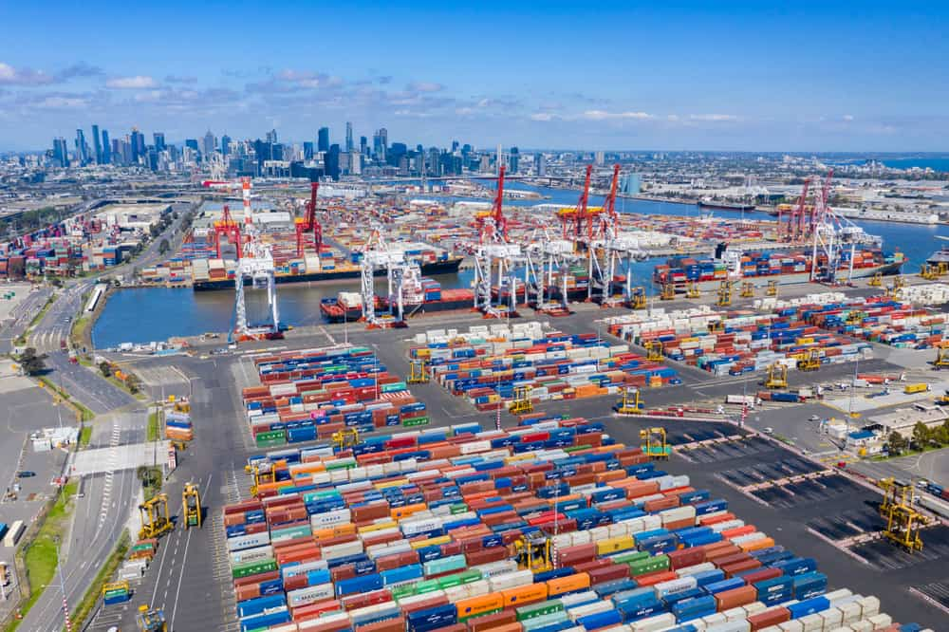
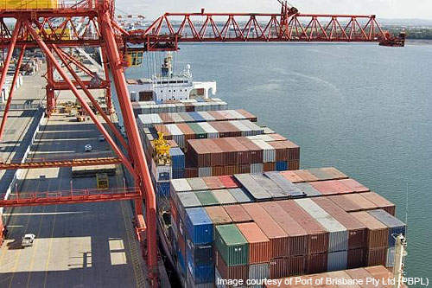
Examples of Port Sustainability Measures
Port of Melbourne | Port operator’s GHG emissions down 73% in 2020-21 (4,927t CO₂-e savings). Assessing net zero Scope 1 and 2 emissions by 2030. 2021-Sustainability-Report-FINAL.pdf (portofmelbourne.com)
Port of Brisbane | Energy Transition Plan to net zero Scope 1 and 2 emissions by 2030. Solar power generation up 299% in 2020-21 (total 1.4MW). 5-star Global Real Estate Sustainability Benchmark (GRESB) rating on sustainability performance. Port of Brisbane - Sustainability Report (portbris.com.au)
Port of Newcastle | Net zero by 2040 target. Operating a Vessel Arrival System since 2011, with 18% GHG emissions reduction per average voyage. 100% renewable electricity used in 2021 (i.e. zero Scope 2 emissions). Transition entire vehicle fleet to electric by 2023. PON-2021-Sustainability-Report.pdf (portofnewcastle.com.au)
Port of Gladstone | 2021 runner-up for the International Association of Ports and Harbors (IAPH) Sustainability Award. Signed Gladstone Hydrogen Ecosystem Memorandum of Understanding with Sumitomo Australia Pty Ltd in 2021 to export hydrogen from the port by 2030. Reports - Gladstone Ports Corporation (gpcl.com.au)
Port Botany and Port Kembla | NSW Ports (port operator for both ports) has a target of net zero Scope 1 and 2 emissions by 2025. As of June 2022, 70% of NSW Ports’ electricity was supplied by wind and solar, including 920 kW of installed solar panels – aims to reach 100% renewably-sourced electricity. NSW Ports is working to define and measure its Scope 3 emissions. 2022 Sustainability Strategy | NSW Ports
Port of Freemantle | Net zero Scope 1 and 2 emissions by 2027. Installing 500 kW solar panel system on Freemantle Cruise Passenger Terminal – to meet all the terminal’s energy needs during cruise ship visits. Fremantle Ports commits to net zero by 2027 - Fremantle Shipping News
Port of Melbourne
Port of Brisbane

Slide 21
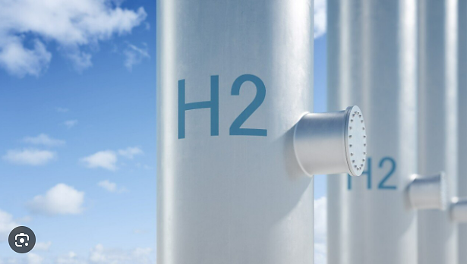
Port Hydrogen Hubs
Port of Newcastle | The Port of Newcastle is redeveloping 220 hectares of industrial wasteland into a dedicated Clean Energy Precinct to help position Newcastle and the Hunter Region as a leading production, storage and export hub for future clean energy products and technologies, including green hydrogen and green ammonia. Port of Newcastle Clean Energy Precinct - Port of Newcastle
Port Kembla | For over 30 years, Port Kembla has been producing, distributing and storing pure and by-product hydrogen (made from natural gas) for industrial use. There are plans to build a hydrogen export terminal at the port for liquefied hydrogen exports including liquefaction plant, storage and pipeline infrastructure. The port can access recycled effluent water from the nearby Wollongong Water Recycling Plant as a feedstock to produce green hydrogen, with the capacity to produce 1,500 tonnes of hydrogen per day. Work is under way to develop a 5GW+ scale green hydrogen hub at the port. Port Kembla Hydrogen Hub
Port of Gladstone | In March 2021, Gladstone Ports Corporation (the port operator) signed a Memorandum of Understanding with Sumitomo Australia, Gladstone Regional Council, Australian Gas Networks and CQUniversity Australia to develop a Gladstone Hydrogen Ecosystem. The project aims to produce renewable hydrogen in Gladstone for domestic use and export through the port by 2030. Hydrogen Utility Pty Ltd (H2U) is investing in the H2-Hub™ Gladstone project to build an industrial-scale green hydrogen and ammonia production complex in proximity to the port with capacity for up to a 3 GW electrolysis plant and up to 5,000 tonnes of green ammonia production per day. Construction is to commence in 2025. Fortescue Future Industries (FFI) plans to build a Green Energy Manufacturing (GEM) Centre in Gladstone – the world’s largest electrolyser production facility with an initial capacity to build up to 2 GW electrolysers annually. H2-Hub Gladstone How Aldoga is leading Queensland’s renewable energy charge
Port Hedland | The WA Government plans to develop five interconnected hydrogen hubs near ports with vast renewable energy facilities (solar and wind) over a 500 km stretch along the Pilbara coastline between Port Hedland and the Port of Asburton by 2030. In July 2022, the Pilbara Ports Authority (PPA) signed a Collaboration Agreement with Yara Clean Ammonia to jointly facilitate the uptake of clean ammonia as a marine fuel in the Pilbara region. WA's massive interconnected H2 hub plans Yara Clean Ammonia and Pilbara Ports Authority team up to assess ammonia as a shipping fuel
Port of Geelong | GeelongPort (the port operator) plans to develop a Geelong Hydrogen Hub as part of its energy precinct. The Hub aims to generate green hydrogen for domestic use and green ammonia for export to Asia. GeelongPort has signed a Memorandum of Understanding with FFI to undertake a joint feasibility study to construct a green hydrogen production facility. A final investment decision is expected to be made at the end of 2024. Geelong Hydrogen Hub

Slide 22
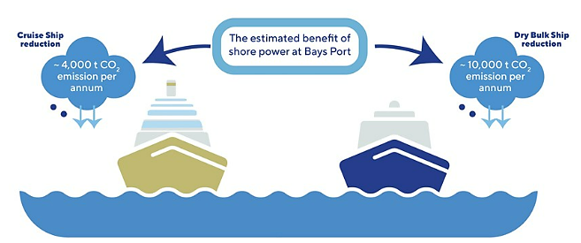
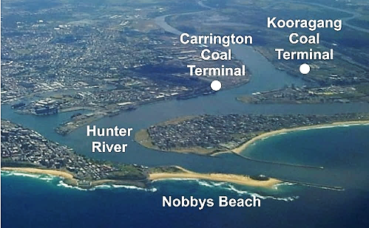
Vessel Arrival System
Onshore Power
In 2010, the Port of Newcastle introduced a Vessel Arrival System (VAS) – the first of its kind in the world at the time – to improve port safety, efficiency and emissions reduction.
The VAS assigns bulk carriers en route to the port a place in the queue and allocates anchoring times ahead of estimated arrivals.
This allows ships to optimise their speed towards the port and reduce time at anchor and berth, thereby saving fuel.
In 2019, the Australian Maritime Safety Authority (AMSA) commissioned DNV GL to quantify the effect of the Port of Newcastle’s VAS on fuel consumption and greenhouse gas (GHG) emissions from arriving ships.
The results indicate that the VAS is effective in improving the efficiency of port turnaround times and reducing fuel consumption.
Ships arriving in Australian ports are estimated to generate on average 9% of their total emissions at berth from running onboard auxiliary engine power systems.
Port renewable Onshore Power Supply (OPS) could help to significantly reduce greenhouse gas emissions from ships at berth.
Additional benefits include reduced noise, odour, and other air pollutants, such as sulphur oxide and particulate matter, which improve environmental and health outcomes for communities living near ports.
In March 2022, the Port Authority of New South Wales announced that it was investing $60 million to develop a 100% certified renewable electricity supply to 4 bulk ship berths and 1 cruise ship berth in the Bays Port Precinct of Sydney Harbour, with supply to 2 berths by 2024.
Average time at berth is 53% less.
Average voyage speed is 23% lower.
Average voyage fuel consumption and GHG emissions are 18% lower.
Port of Newcastle
Shore Power | portauthoritynsw.com.au

Slide 23
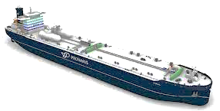
Supplying Low or Zero Carbon Marine Fuels
Australian Private Sector Initiatives
Some major green hydrogen and ammonia projects being developed by Australian companies include:
Fortescue Metals Group | Developing a global portfolio of green energy projects in over 30 countries. Major projects in Australia include: A 250 MW green hydrogen and ammonia plant in Bell Bay, an industrial and port precinct, with the capacity to produce 250,000 tonnes of green ammonia per year for domestic use and export. Construction of a Green Energy Manufacturing centre near Port of Gladstone. Fortescue Green Hydrogen and Ammonia Plant – HyResource (csiro.au) How Aldoga is leading Queensland’s renewable energy charge
BP, InterContinental Energy, CWP Global, Macquarie Capital and Macquarie Green Investment Group | Developing the Asian Renewable Energy Hub (AREH) in the Pilbara, east of Port Hedland. Proposed 26GW wind and solar renewable energy facility with the capacity to produce 1.6 million tonnes of green hydrogen or 9 million tonnes of green ammonia per year. Abate around 17 million tonnes of carbon dioxide in domestic and export markets annually. The project is currently working to obtain relevant regulatory approvals. Australian Renewable Energy Hub – HyResource (csiro.au)
Provaris | Building a 2.8GW green hydrogen export facility on the Tiwi Islands, Northern Australia, to be integrated with a fleet of Provaris’ compressed hydrogen H2Neo carriers under development. Aims to produce 100,000 tonnes of green hydrogen per year for export from Port Melville to Asia Pacific markets. Financial close for the project is targeted for late 2024/early 2025, with first hydrogen export targeted to commence in early 2028. Tiwi H2 – HyResource (csiro.au)
CS Energy | Partnering with Japanese companies Sojitz Corporation and Nippon Engineering Consultants to produce and transport renewable hydrogen from Chinchilla, Queensland, to Pacific Island countries for use in small fuel cells and hydrogen fuel cell vessels. Kogan Renewable Hydrogen Demonstration Plant - CS Energy
Mirning Green Energy limited, InterContinental Energy, CWP Global | Developing the Western Green Energy Hub (WGEH) in south-east Western Australia to produce up to 50GW of renewable wind and solar power. Capacity to produce up to 3.5 million tonnes of green hydrogen or around 20 million tonnes of green ammonia per year. Western Green Energy Hub – HyResource (csiro.au)

Slide 24
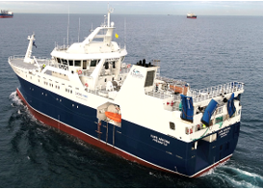
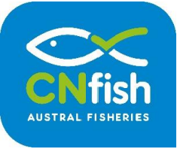
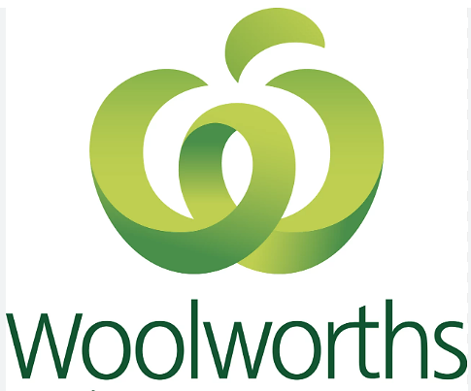
Green Vessels
Sustainable Fishing
Smaller vessels operating on shorter voyages provide opportunities for early trialling and adoption of low and zero carbon technologies. Australian companies are at the forefront of designing and building high speed passenger craft.
Austral Fisheries - Australia’s leading integrated commercial fishing company - is committed to delivering sustainable seafood.
Incat Tasmania | Australian manufacturer of high speed craft. Contructing world’s largest battery-electric Ro-Pax ferry for South American customer, Buquebus. Incat Tasmania to deliver the World’s largest Battery Electric Ship
Incat Crowther | World leader in designing high speed ferries. Designed Sea Change launched in 2021 – world’s first zero-emissions hydrogen fuel cell-powered electric-drive high speed passenger ferry for the San Francisco Bay Area. Designing an electric hybrid fast ferry for Auckland Transport. Zero-Emission Hydrogen Fuel Cell Ferry Hits The Water Auckland Transport Announces New Incat Crowther-Designed Hybrid Electric Ferry
SeaLink | Commenced a project in 2022 to design and build Australia’s first green hydrogen fuel cell-powered passenger ferry to operate as a shuttle between Gladstone and LNG facilities on nearby Curtis Island. Hydrogen to power new Gladstone ferry - Ministerial Media Statements
Austal Australia | Launched its new VOLTA series of electric-powered high-speed ferry designs in 2021. Volta by Austal
Ricochet Yachting | Launched the H2Rendezvous project to develop a green hydrogen eco-tourism vessel for the Great Barrier Reef. Australia's First Hydrogen Powered Tourism Vessel
ANL and Woolworths | Successfully completed the first biofuel-powered containerised 42-day voyage trial in Oceania in April 2022. Used a B20 biofuel blend from used cooking oil supplied by Queensland-based EcoTech, with BP Marine and Port of Brisbane playing a key role in supplying and bunkering the blended fuel. ANL Completes Biofuel Powered Voyage in Oceania
In 1997, Austral became the world’s first fishing company to sign up to the Marine Stewardship Council (MSC) – a sustainable and traceable international certification for wild fishing. The MSC has certified all four of Austral’s major Australian fisheries as sustainable and well-managed.
2016- Austral became the first seafood business in the world to be certified as carbon neutral.
A majority of Austral’s emissions are from using diesel fuel in its fishing vessels. Austral is investing in measures to make its fleet more efficient.
In 2020, it replaced one of its older, less efficient vessels with the Cape Arkona – a new $50 million, hybrid diesel and battery-powered vessel, the only one of its kind in Australia.
The multi-purpose fishing vessel, capable of operating long-lines, trawling and potting, runs on substantially less fuel, making it possible for the vessel to stay longer at sea, travel further and require fewer trips to port for refuelling.
Austral’s Cape Arkona Vessel
Austral’s Carbon Neutral (CN) Fish logo
Sustainability | Austral Fisheries

Slide 25
Australian Governments (Federal, State, Territory)
Summary of actions to reduce maritime emissions
investing in the development of clean hydrogen industrial hubs near ports to produce renewable hydrogen-derived fuels for domestic use and export (including for fuelling ships)
reviewing and developing responsive regulatory frameworks to accommodate technological advancements in the clean energy space
including developing a domestic Guarantee of Origin (GO) certification scheme by the Federal Government to track and certify emissions from locally-produced hydrogen
engaging in international partnerships to establish hydrogen value chains and accelerate the deployment of low and zero carbon maritime technologies
the Federal government has also signed up to several international green shipping corridor initiatives
working to sustainably manage 100% of our national waters, guided by a national Sustainable Ocean Plan, by 2025
developing a Maritime Single Window to improve port efficiency and reduce emissions.

Slide 26
Australian Ports
incorporating sustainability considerations (including efficiency and emissions reduction measures) in core business planning and operations to future-proof ports
monitoring and reporting their greenhouse gas emissions
major Australian port operators have set net zero Scope 1 and 2 emissions by 2030 or earlier
investing in studies and port infrastructure to become ‘hydrogen-ready’ for local use, bunkering and export
implementing a Vessel Arrival System (currently at Port of Newcastle)
establishing renewable onshore power (currently planned for Sydney Harbour by 2024)

Slide 27
Australian Companies and Businesses
investing in scaling up the production of renewable fuels
designing and building green vessels, particularly in niche markets (e.g. high-speed passenger craft)
partnering with other international companies to establish specific green shipping corridors
developing low emissions maritime technologies and enabling infrastructure (e.g. electric vehicle charging stations at ports)
offering carbon neutral shipping options
adopting sustainable fishing practices, including converting to more efficient, less fuel intensive, fishing vessels
establishing multi-sectorial collaborative platforms and key stakeholder networks to share information and improve strategic coordination to decarbonise the maritime sector

