Slide 1







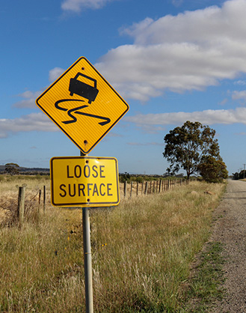


Page 1
Consultation Regulatory Impact Analysis (RIA)
Reducing default speed limits outside of built-up areas
This RIA assesses proposed changes to default speed limits on roads without a sign-posted speed limit. It does not propose, nor consider, changes to any current sign-posted speed limits.
The problem – high levels of road trauma are occurring on regional and remote roads
10% increase in road fatalities per 100,000 population over the period 2020 to 2024
Australia’s road fatality rate per 100,000 population was 8.5% higher than the OECD median fatality rate in 2023
65% of Australia’s road fatalities over the last decade occurred outside of major cities
of road deaths outside of major cities, 85% occurred on roads with speed limits at and above 80km/h
$30 billion annual cost of road trauma nationally
While crashes result from a range of factors, speed remains the single most significant contributor to road trauma
Why is further government action needed in managing default speed limits?
Increasing road trauma despite improvements in vehicle safety technology and ongoing action by all governments.
Speed management is an essential component of a comprehensive road safety approach that offers practical value as a proven, cost-effective intervention.
There is a role for governments in setting safety standards and regulation across the road network where there is risk, in order to achieve a societal benefit.
Without action on default speed limits and other safety measures, Australia will not meet its national road trauma reduction target of halving road deaths by 2030.
Speed reduction options and their impacts
REFORM OPTIONS
IMPACT MEASURED
Reduce current 100km/h default speed limit outside built-up areas to:
Benefits
Avoided:
road fatalities and serious
injuries
fuel consumption costs
emissions from fuel consumption
Sealed roads
Option 1: 90 km/h
Option 2: 80 km/h
Option 3: 70 km/h
Costs
Increased travel time (private, business and logistics)
Administrative government costs
Unsealed roads
Option 1: 80 km/h
Option 2: 70 km/h
The reform options would also have a number of intangible social and environmental impacts that are not measured.

Slide 2
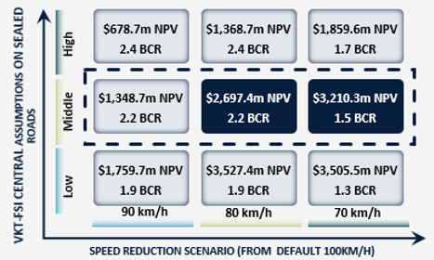
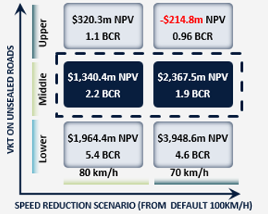
Page 2
Consultation Regulatory Impact Analysis (RIA)
Reducing default speed limits outside of built-up areas
Analysis approach – scenario-based modelling
DATA LIMITATIONS
OUR APPROACH
Developing a single national estimate of impacts from speed limit changes outside built-up areas is difficult due to limited data on:
how many roads are unsigned, sealed, or unsealed
how much driving occurs on these roads (the vehicle-kilometres travelled, or VKT)
the share of fatal and serious injury (FSI) crashes on these roads.
Given these data limitations, this Consultation RIA uses scenario modelling. This approach:
tests best- and worst-case assumptions
shows a range of results (rather than a single figure)
Identifies when reforms are likely to deliver net benefits under different conditions.
Findings – potential impacts under different scenarios
SEALED ROADS
UNSEALED ROADS
NPV = Net Present Value. A policy is beneficial to society if NPV>0.
The option with the largest NPV should generally be favoured.
BCR = Benefit-cost ratio, a ratio of the present value of total benefits to the present value of total costs. A policy is beneficial to society if BCR>1.
KEY FINDINGS
Lowering default speed limits outside built-up areas delivers a net societal benefit across all scenarios, for both sealed and unsealed roads.
Under central assumptions:
  70 km/h offers the highest total benefits, but at higher costs.
    On sealed roads, this option doubles the benefits of 80 km/h but triples the costs.
    For sealed roads, this speed reduction avoids 572 annual fatalities and 9,287 serious injuries, and 248 fatalities and 8,847 serious injuries for unsealed roads.
  80 km/h offers a balance between benefits and costs.
    Every $1 spent delivers $2.20 in benefits, vs. between $1.50 (on sealed roads) and $1.90 (on unsealed roads) at 70 km/h.
    For sealed roads, this speed reduction avoids 401 annual fatalities and 6,312 serious injuries, and 123 fatalities and 4,182 serious injuries for unsealed roads.
There is a trade-off in considering a preferred option.
Following consultation, the Decision RIA will recommend a preferred option to amend the Australian Road Rules. State and territory governments may consider alternate options that will deliver net benefits, as well as other jurisdictional considerations, when amending their road rules.

