Slide 1

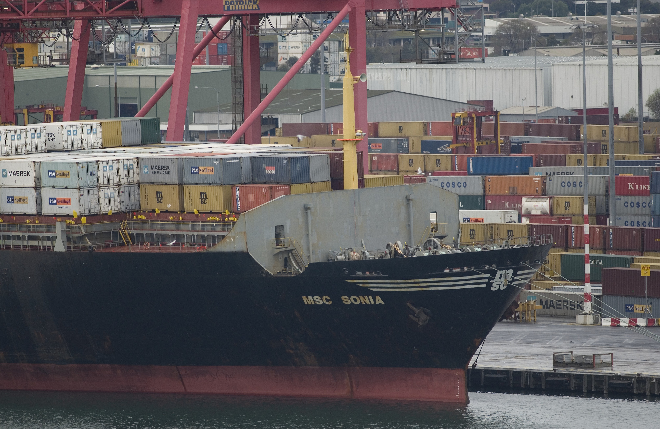
Quarterly Delegate Decisions Coastal Trading (Revitalising Australian Shipping) Act 2012
OFFICIAL
July - September 2025
OFFICIAL

Slide 2

OFFICIAL
Application Decisions – July to September 2025
Temporary Licence Voyage Load Ports – July to September 2025
Major Passenger Vessels
Temporary Licence Voyages Completed by Cargo
July to September 2025
General Licence Vessels
Temporary Licence Voyage Discharge Ports – July to September 2025
Contact us
Temporary Licence Usage (by Cargo) - July to September 2024 vs July to September 2025
Coastal Trading (Revitalising Australian Shipping) Act 2012
Objectives
Licences
Considerations for Approval
Grounds for Refusal
OFFICIAL

Slide 3
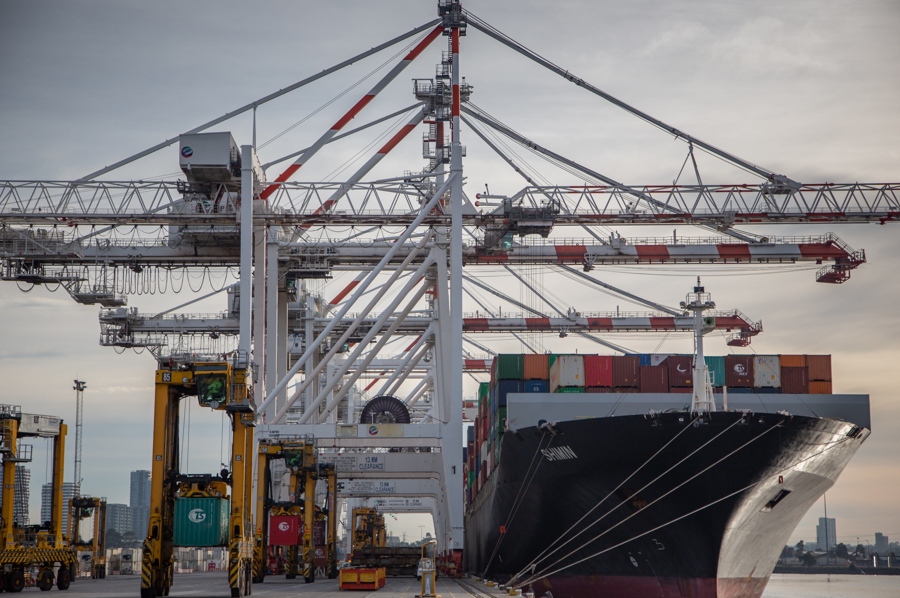
OFFICIAL
Home
Application Decisions – July to September 2025
Application Type | Applications Approved | Applications Refused | Notices in Response | Applications Withdrawn
General Licence | 1 | 0 | 0 | 0
Temporary Licence | 10 | 0 | 0 | 0
Temporary Licence (New Matters) | 84 | 0 | 0 | 1
Temporary Licence (Authorised Matters) | 149 | 0 | 0 | 4
Temporary Licence (Energy/Security) | 0 | 0 | 0 | 0
The Department also received 13 section 12 declarations, with 1 declaration withdrawn.
OFFICIAL

Slide 4
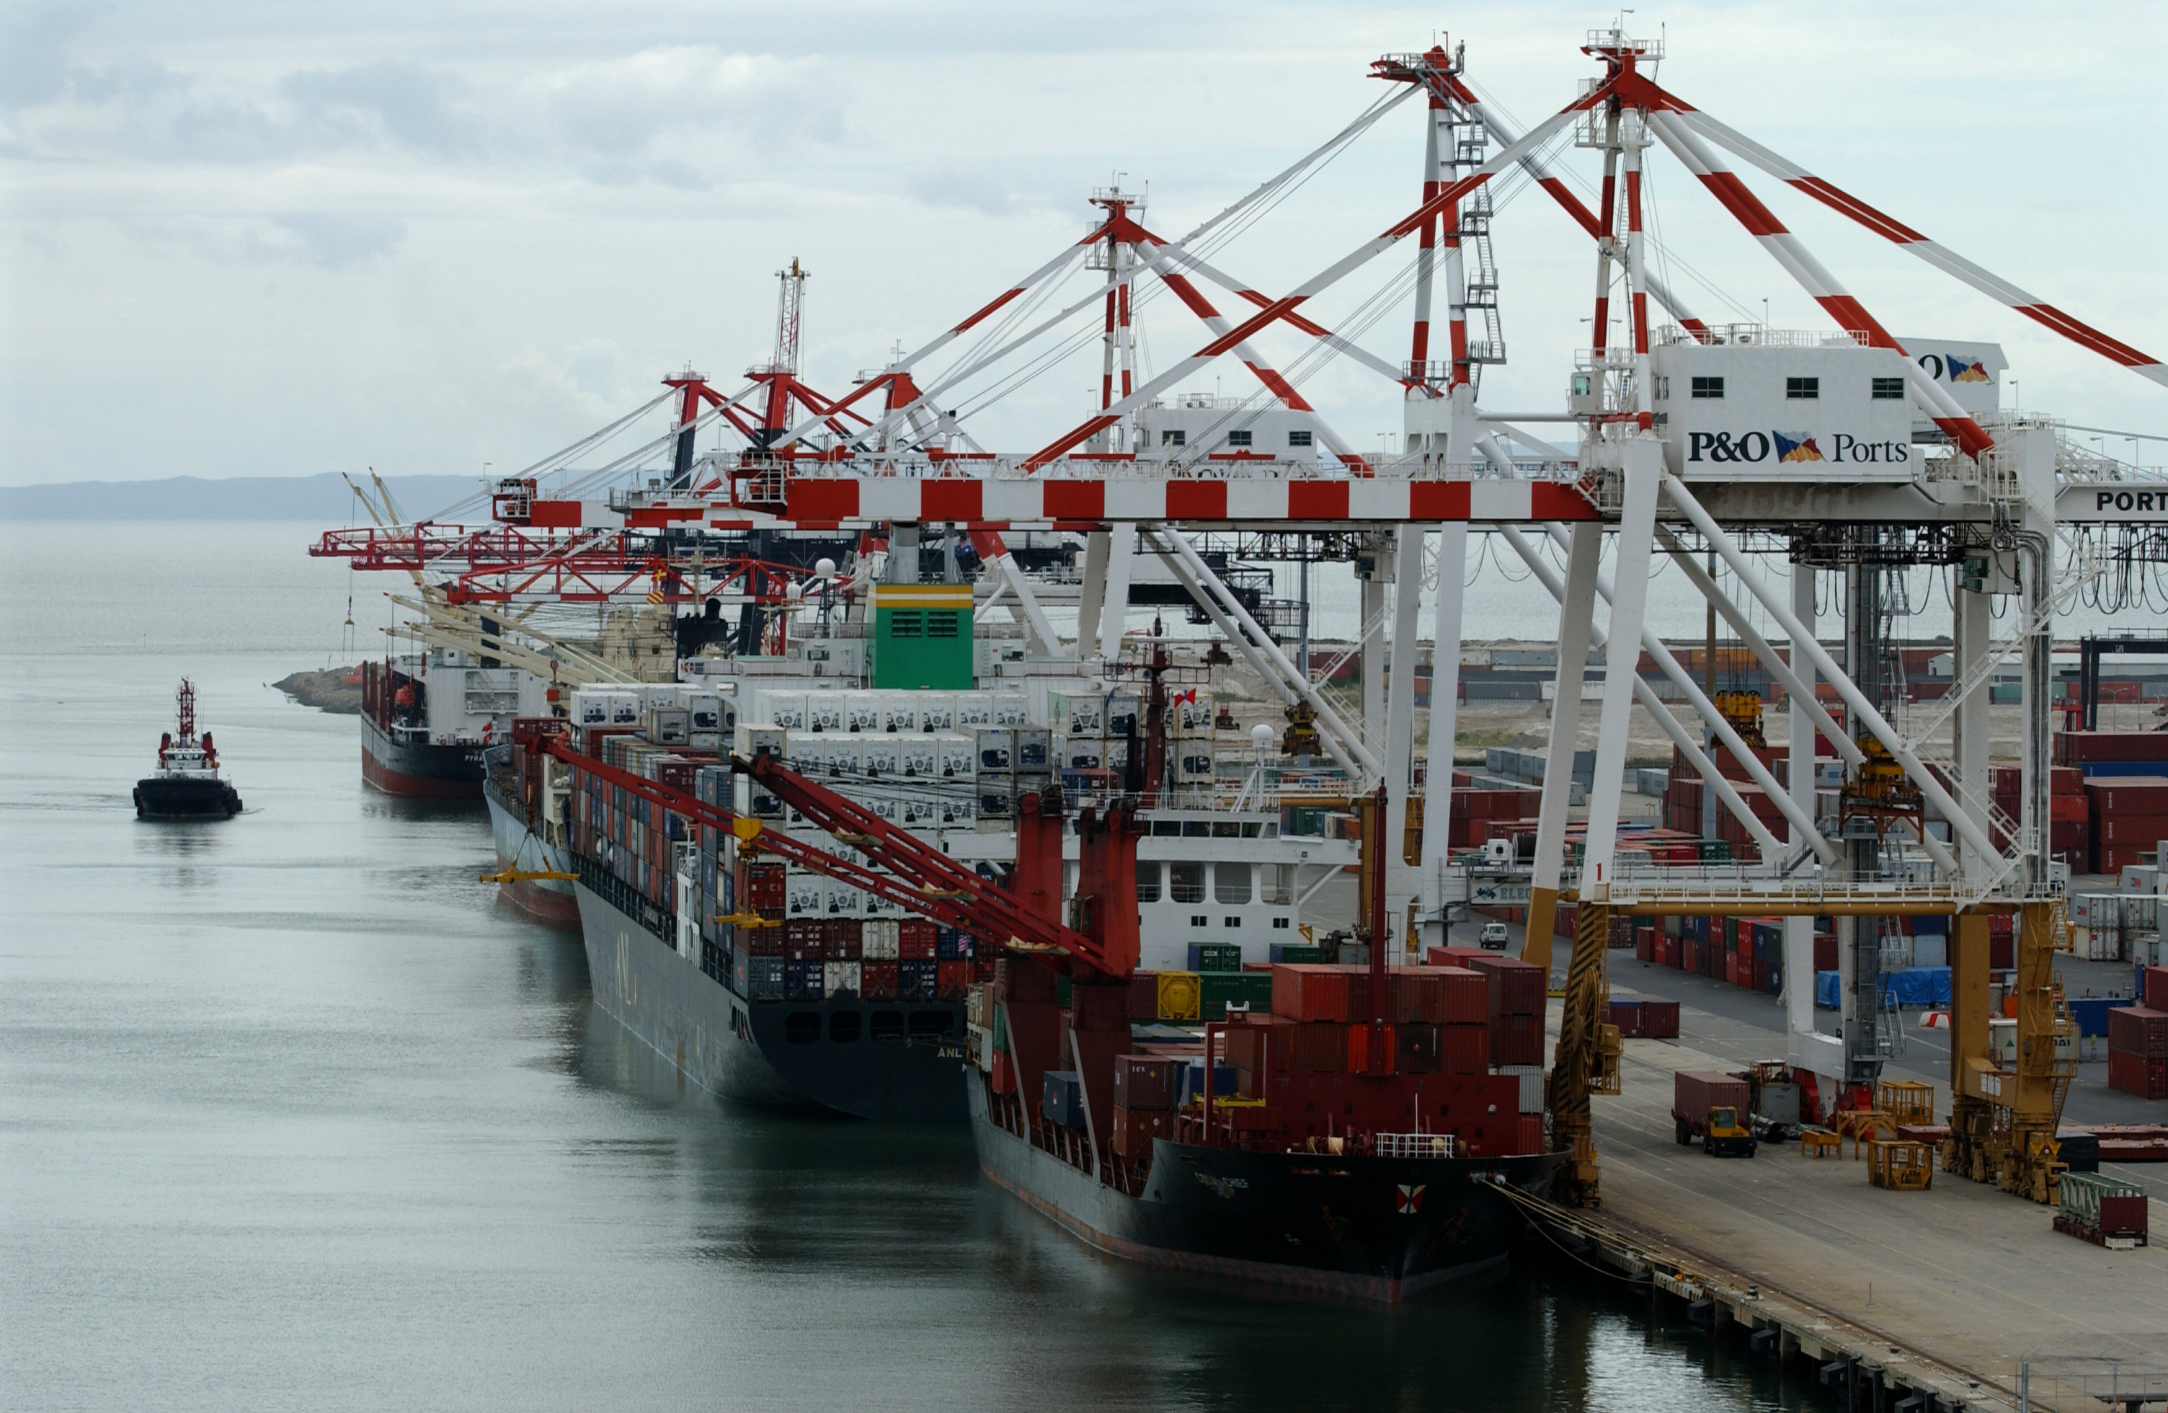
OFFICIAL
Home
Temporary Licence Voyages Completed by Cargo - July to September 2025
OFFICIAL

Slide 5

OFFICIAL
Home
Temporary Licence Voyage Load Ports -
July to September 2025 (top 20)
OFFICIAL

Slide 6
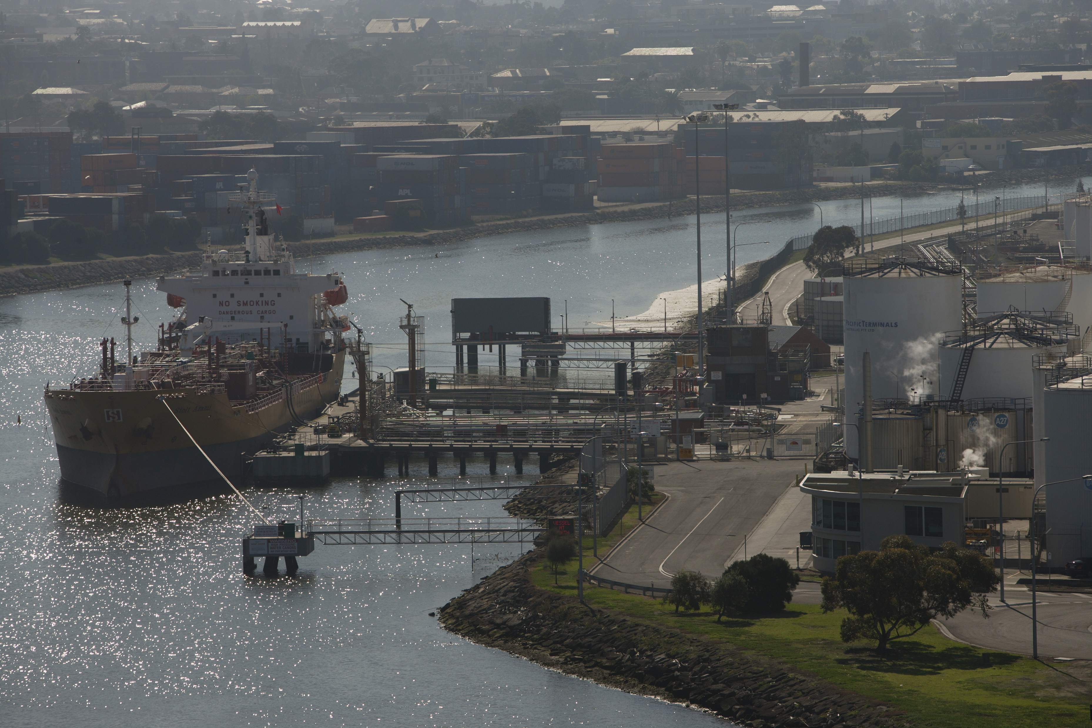
OFFICIAL
Home
Temporary Licence Voyage Discharge Ports -
July to September 2025 (top 20)
112
OFFICIAL

Slide 7
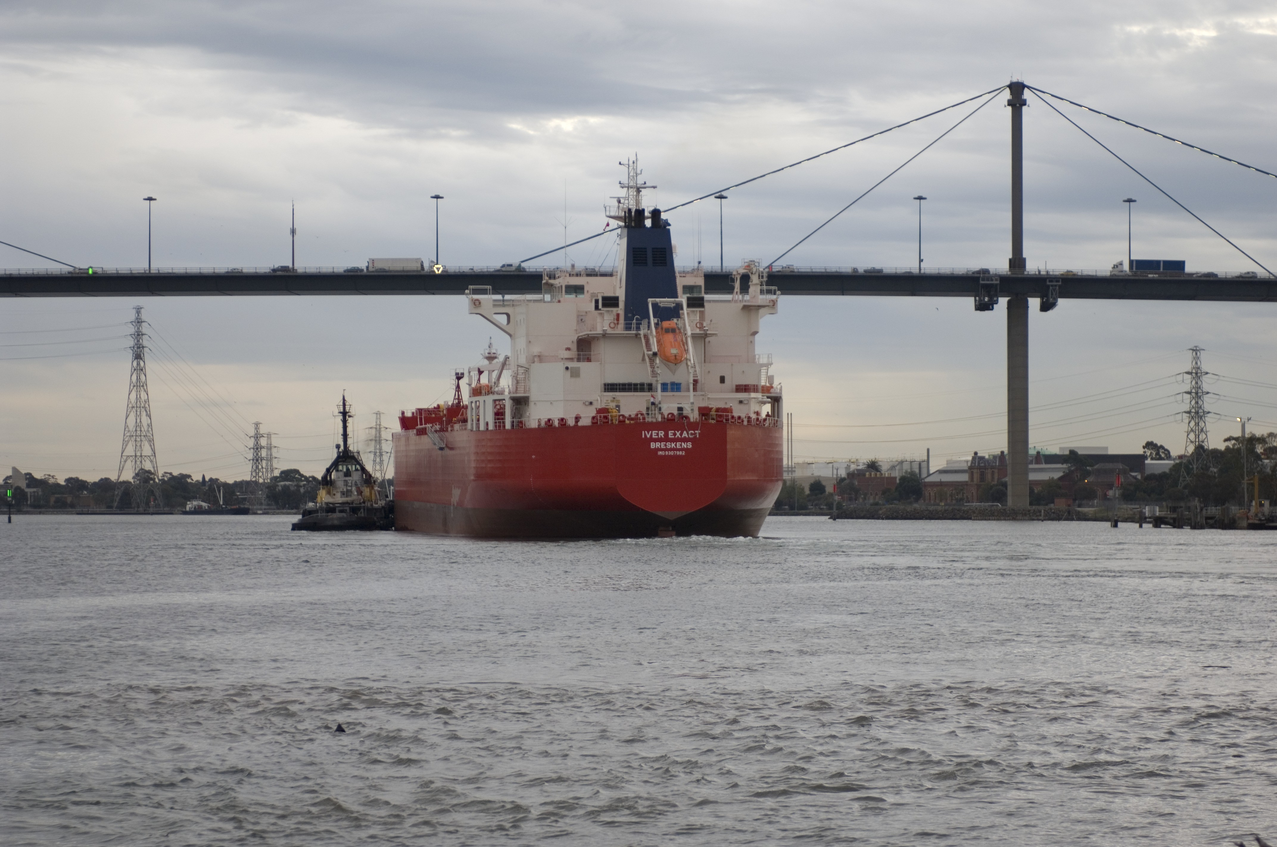
OFFICIAL
Home
Temporary Licence Usage (by Cargo) –
July to September 2024 vs July to September 2025
OFFICIAL

Slide 8
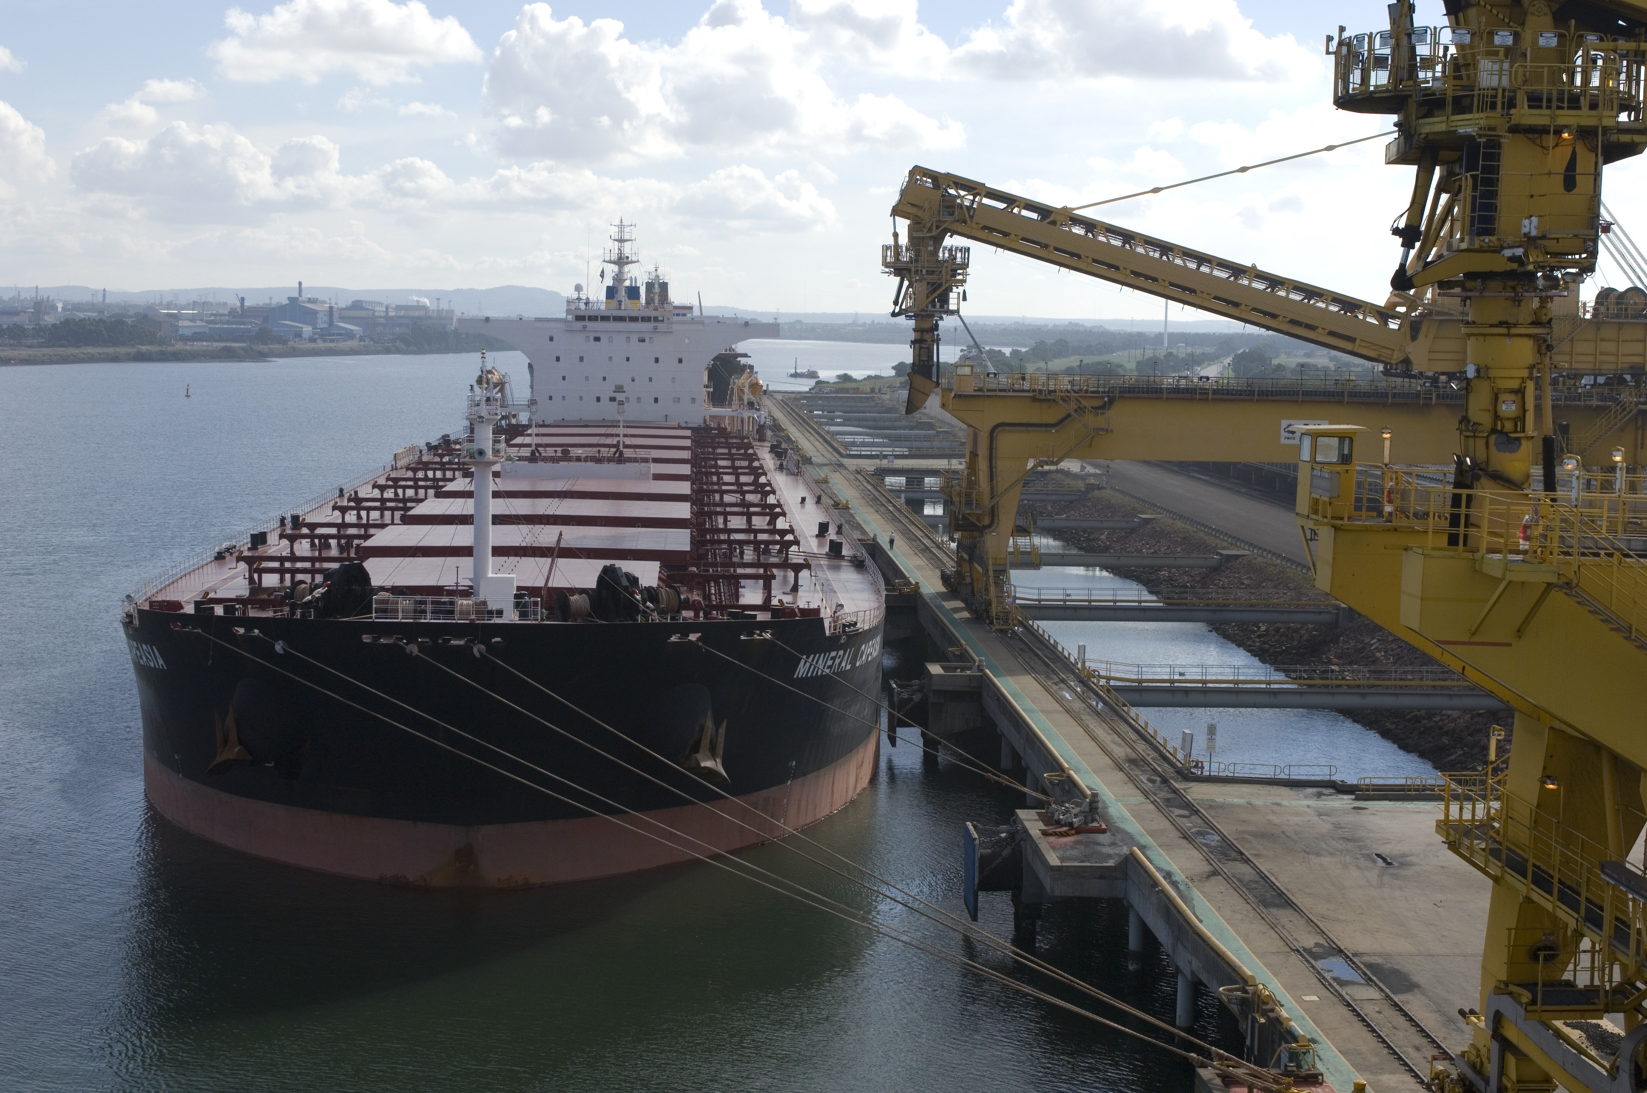
OFFICIAL
Home
General Licence Vessels (Major Trading Fleet)
Vessel Name | General Licence Holder | Vessel Type
Donnacona | CSL Australia | Self-Discharging Bulk Carrier
Goliath | CSL Australia | Cement Carrier
Tasmanian Achiever II | Strait Link QS Pty Ltd | Ro-Ro Cargo Ship
Victorian Reliance II | Strait Link QS Pty Ltd | Ro-Ro Cargo Ship
MV Liekut | SeaRoad Shipping Pty Ltd | Ro-Ro Cargo Ship
Accolade II | Inco Ships | Limestone Carrier
Searoad Mersey II | SeaRoad Shipping Pty Ltd | Ro-Ro Cargo Ship
Spirit of Tasmania I | TT Line Company Pty Ltd | Passenger/Ro-Ro Ship
Spirit of Tasmania II | TT Line Company Pty Ltd | Passenger/Ro-Ro Ship
Newcastle Bay | Sea Swift Pty Ltd | General Cargo
John Duigan | ASP Ship Management Pty Ltd | Landing Craft
OFFICIAL

Slide 9
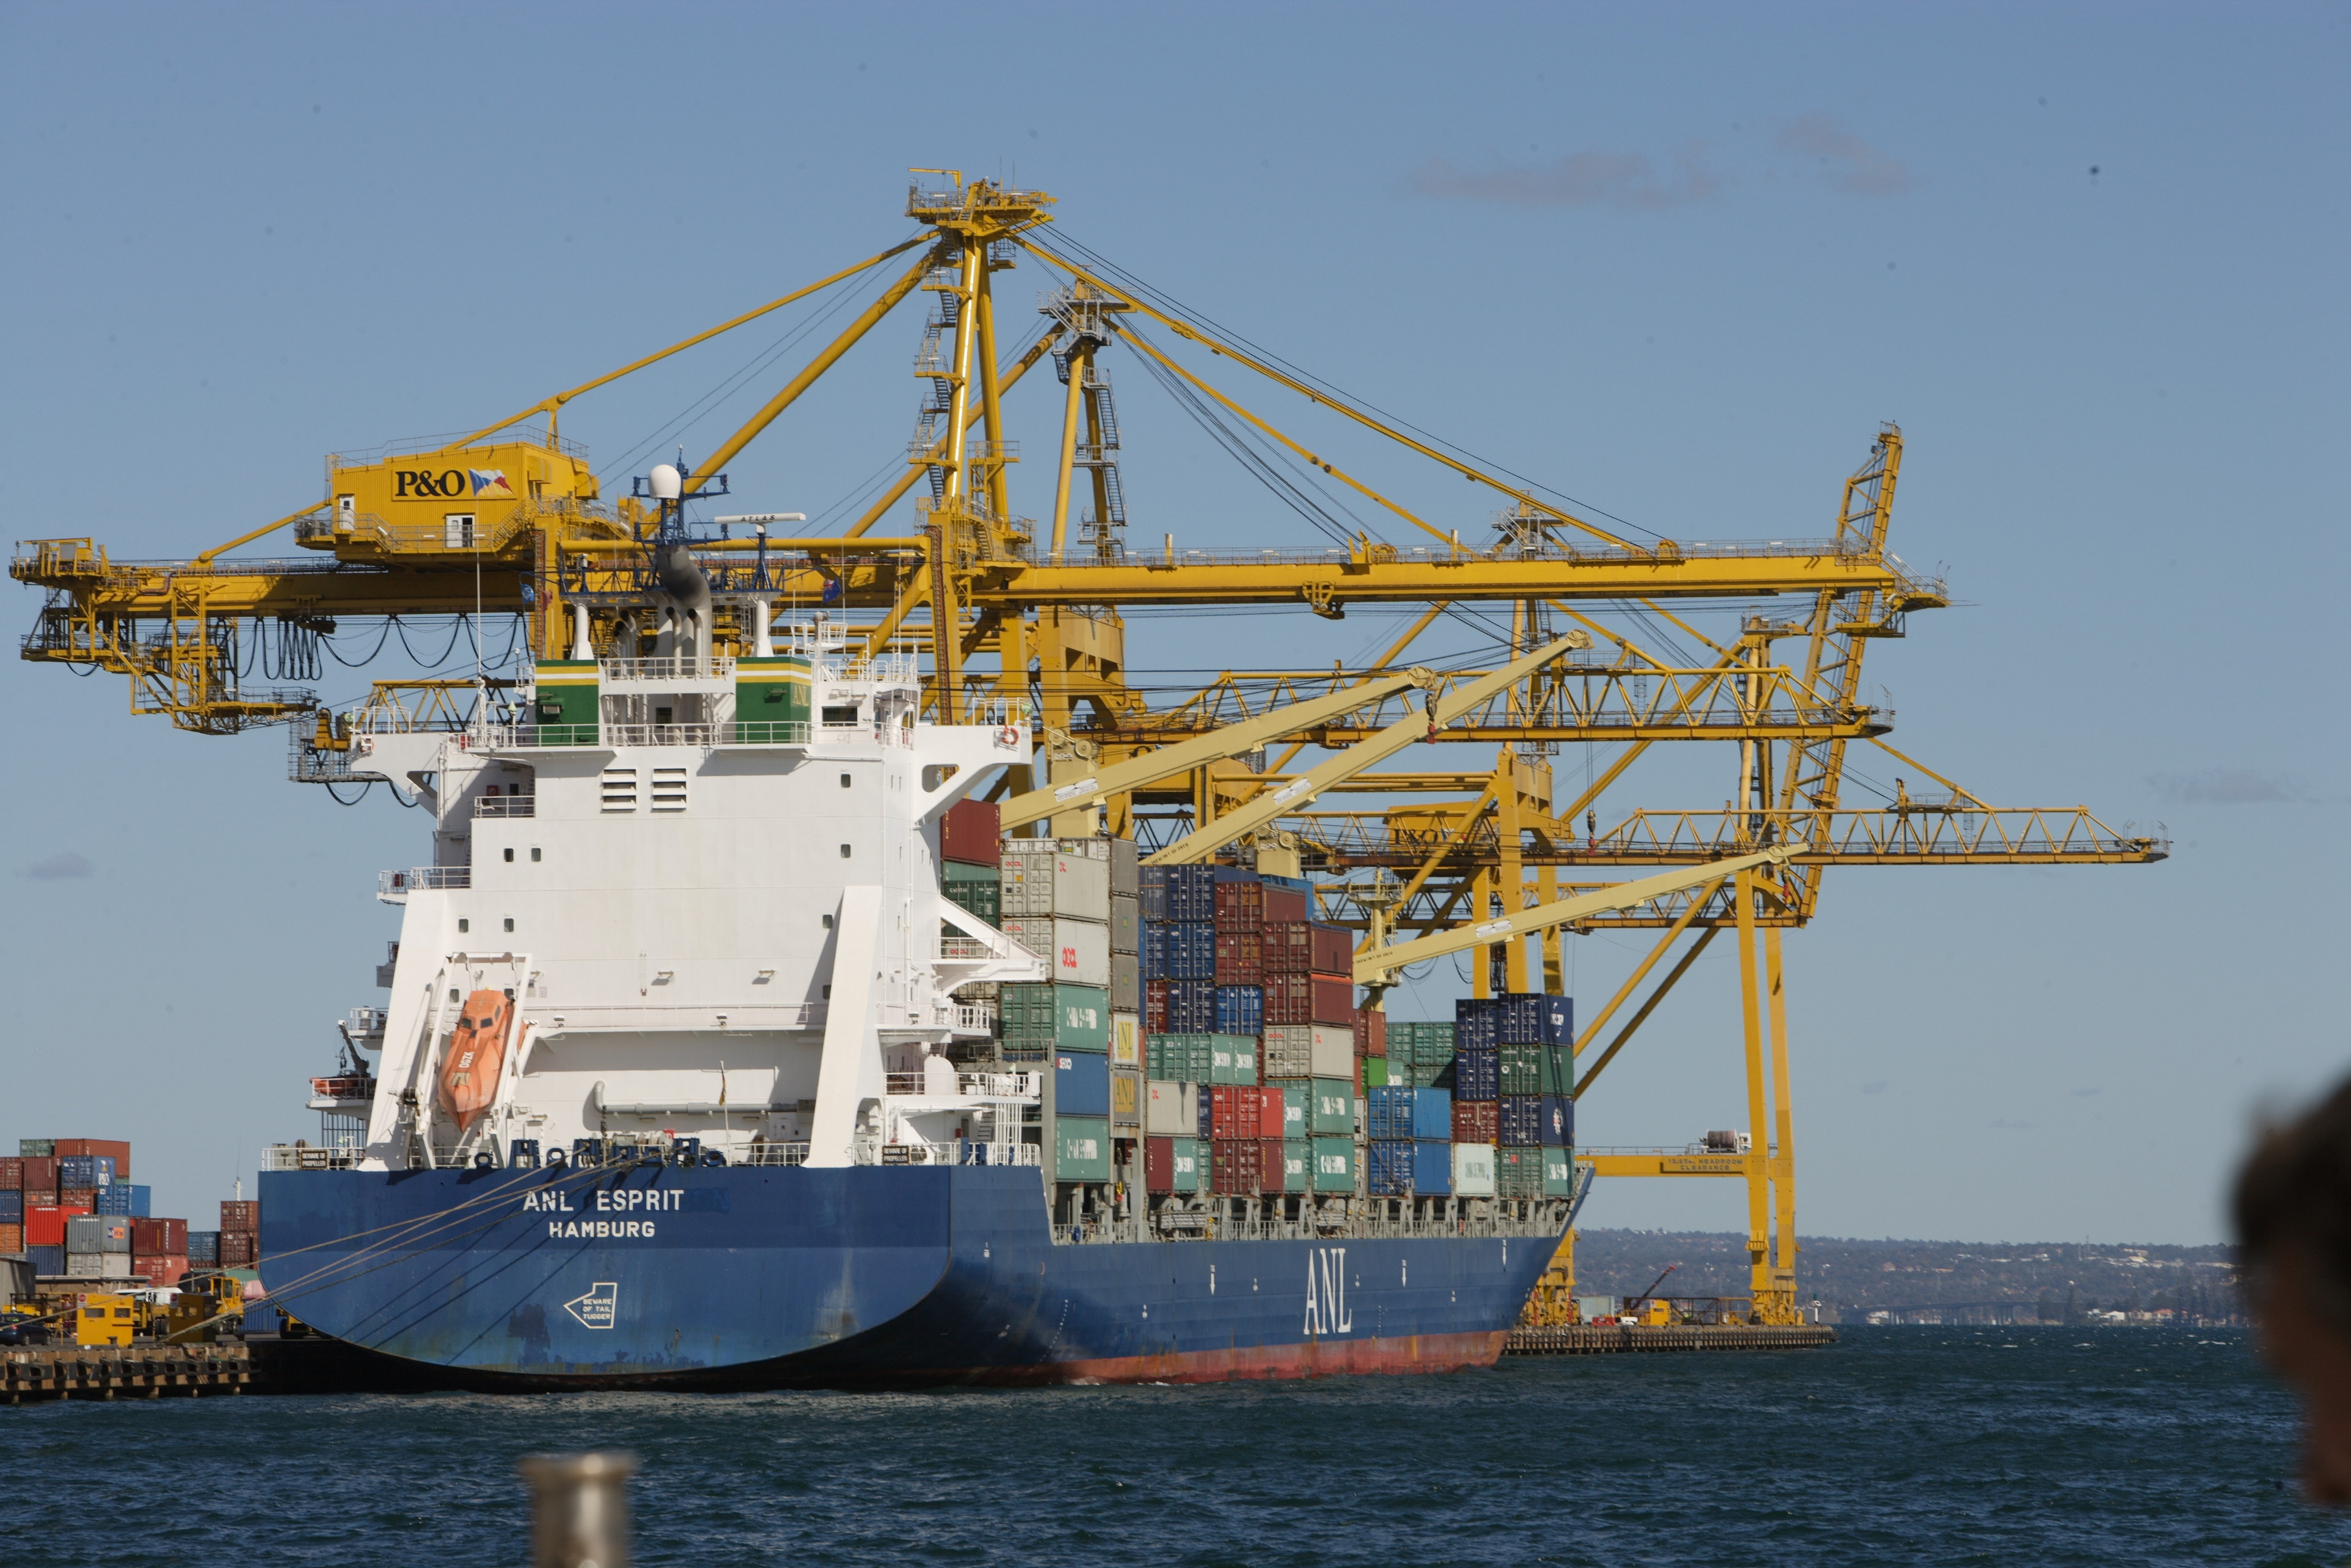
OFFICIAL
Home
Major Passenger Vessels
Vessel Name | General Licence Holder
Coral Geographer | Coral Princess Cruises (NQ) Pty Ltd
Coral Adventurer | Coral Princess Cruises (NQ) Pty Ltd
Coral Discoverer | Coral Princess Cruises (NQ) Pty Ltd
True North | North Star Cruises
True North II | North Star Cruises
OFFICIAL

Slide 10
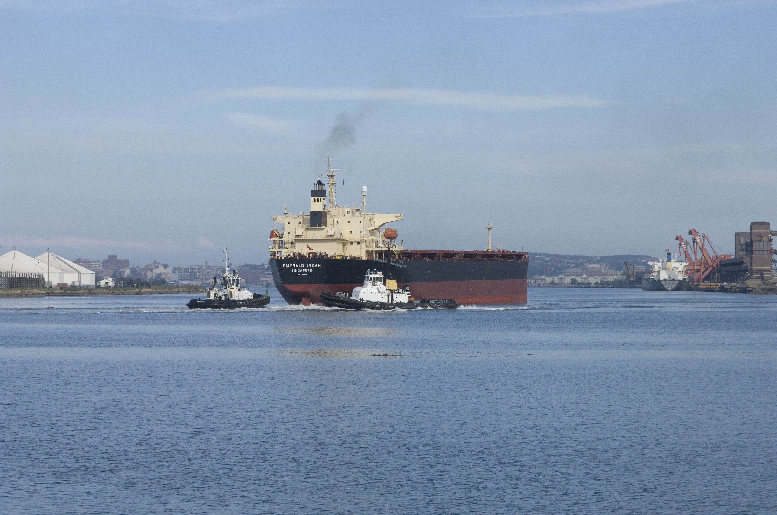
OFFICIAL
Home
Objectives
The objectives of the Coastal Trading (Revitalising Australian Shipping) Act 2012 (Coastal Trading Act) are to provide a regulatory framework for coastal trading in Australia that:
(a) promotes a viable shipping industry that contributes to the broader Australian economy.
(b) facilitates the long-term growth of the Australian shipping industry.
(c) enhances the efficiency and reliability of Australian shipping as part of the national transport system.
(d) maximises the use of vessels registered in the Australian General Shipping Register in coastal trading.
(e) promotes competition in coastal trading.
(f) ensures efficient movement of passengers and cargo between Australian ports.
Source: Section 3 of the Coastal Trading (Revitalising Australian Shipping) Act 2012
OFFICIAL

Slide 11
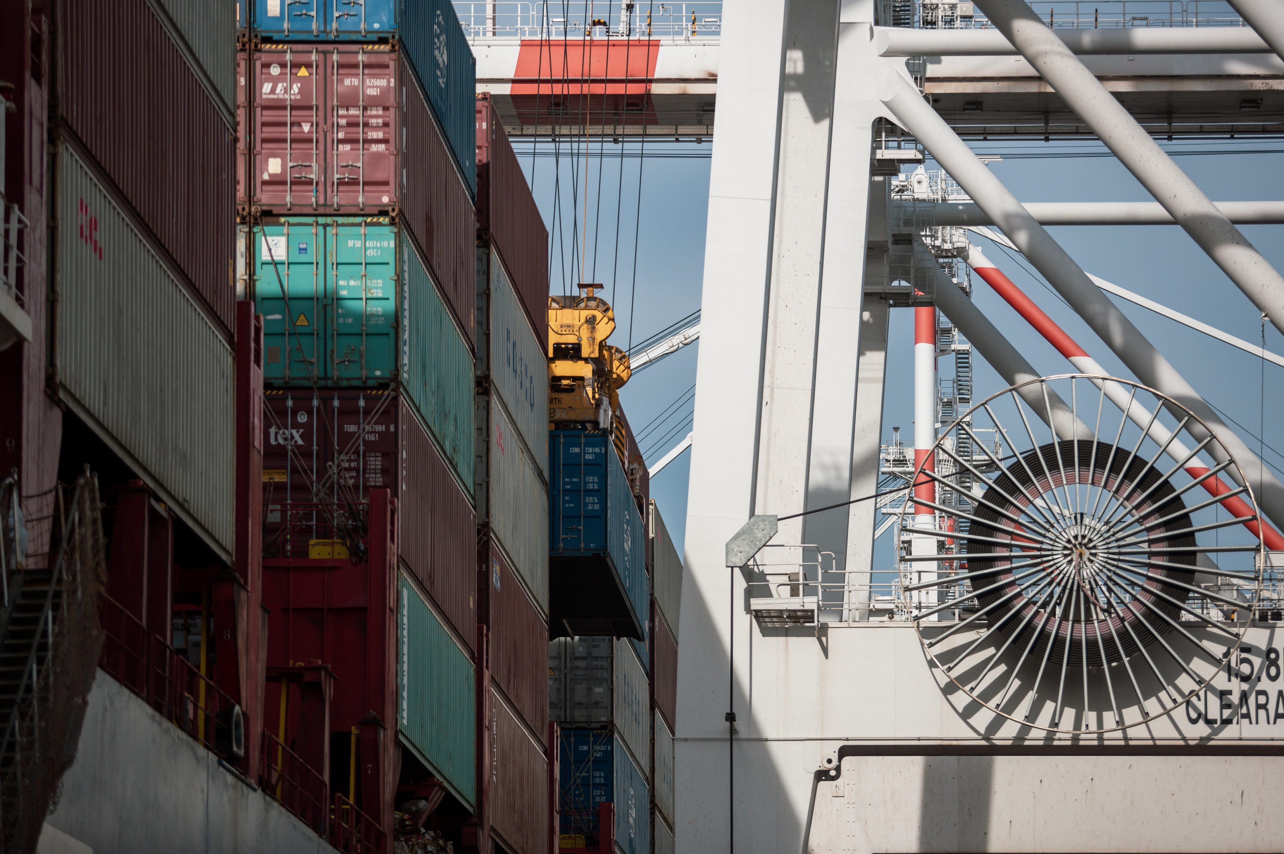
OFFICIAL
Home
Licences
The Coastal Trading (Revitalising Australian Shipping) Act 2012 provides for three types of licence: general licences, temporary licences and emergency licences.
A general licence is for Australian General Shipping Register vessels (Australian flagged vessels) and provides unrestricted access to engage in coastal trading in Australian waters for five years.
A temporary licence provides access to engage in coastal trading in Australian waters for foreign-flagged vessels—this licence is valid for 12 months and is limited to the voyages authorised by the licence. Voyages can be amended or added to a temporary licence through new matters, authorised matters or energy security situation variations.
An emergency licence provides access to engage in coastal trading in Australian waters in identified emergency situations – this licence may be granted for up to 30 days.
The definition of coastal trading excludes intrastate trading (movements from a port in a state or territory to another port in the same state or territory). An applicant seeking the Coastal Trading (Revitalising Australian Shipping) Act 2012 to apply to a particular vessel that will undertake intrastate trading can apply for a declaration under section 12 of the Coastal Trading (Revitalising Australian Shipping) Act 2012.
Under section 11 of the Act, the Minister may exempt certain vessels or persons. The current section 11 exemptions include:
cruise vessels
voyages between Norfolk Island and Australian states and territories
voyages between Christmas Island and Australian states and territories
voyages between Cocos (Keeling) Island and Australian states and territories
OFFICIAL

Slide 12
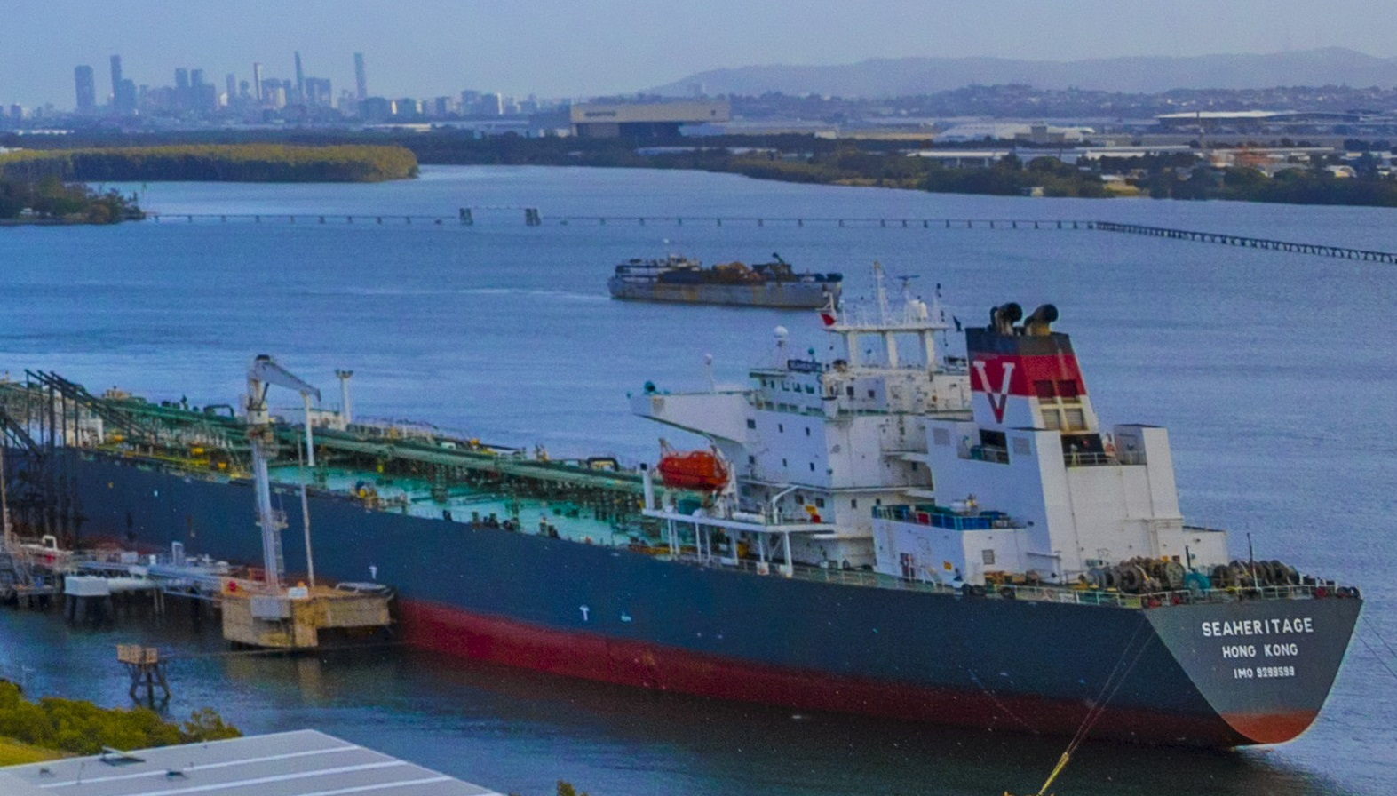
OFFICIAL
Home
Considerations for Approval
Depending on the type of licence, in deciding an application, the Minister (or the delegate) may have regard to the following (whether or not the Minister (or delegate) receives a notice in response in relation to the application):
whether the applicant has previously held, or applied for a licence.
whether the applicant has previously held a licence that was cancelled.
whether the applicant has been issued with an infringement notice under this Act.
the object of the Act.
any other matters the Minister thinks relevant.
In addition, for temporary licences the Minister may also have regard for:
if the application relates to cargo and a vessel registered in the Australian International Shipping Register—both:
(i) whether the applicant owns the cargo and the vessel; and
(ii) whether the cargo is to be carried on the vessel;
any written comments received by the Minister in relation to the application.
any report given to the Department by the applicant under section 62.
If the Minister receives one or more notices in response in relation to an application, the Minister must have regard to the following in deciding the application:
the outcome of negotiations, as notified by the applicant.
whether, and to what extent, the vessel authorised by the holder’s general licence is equipped to carry
the passengers or cargo specified in the application.
whether those passengers or cargo can be carried on the expected loading dates or within 5 days before or after the relevant date.
if the application relates to the carriage of cargo—the reasonable requirements of a shipper of the kind of cargo specified in the application.
Source: Section 15 of the Coastal Trading (Revitalising Australian Shipping) Act 2012
OFFICIAL

Slide 13
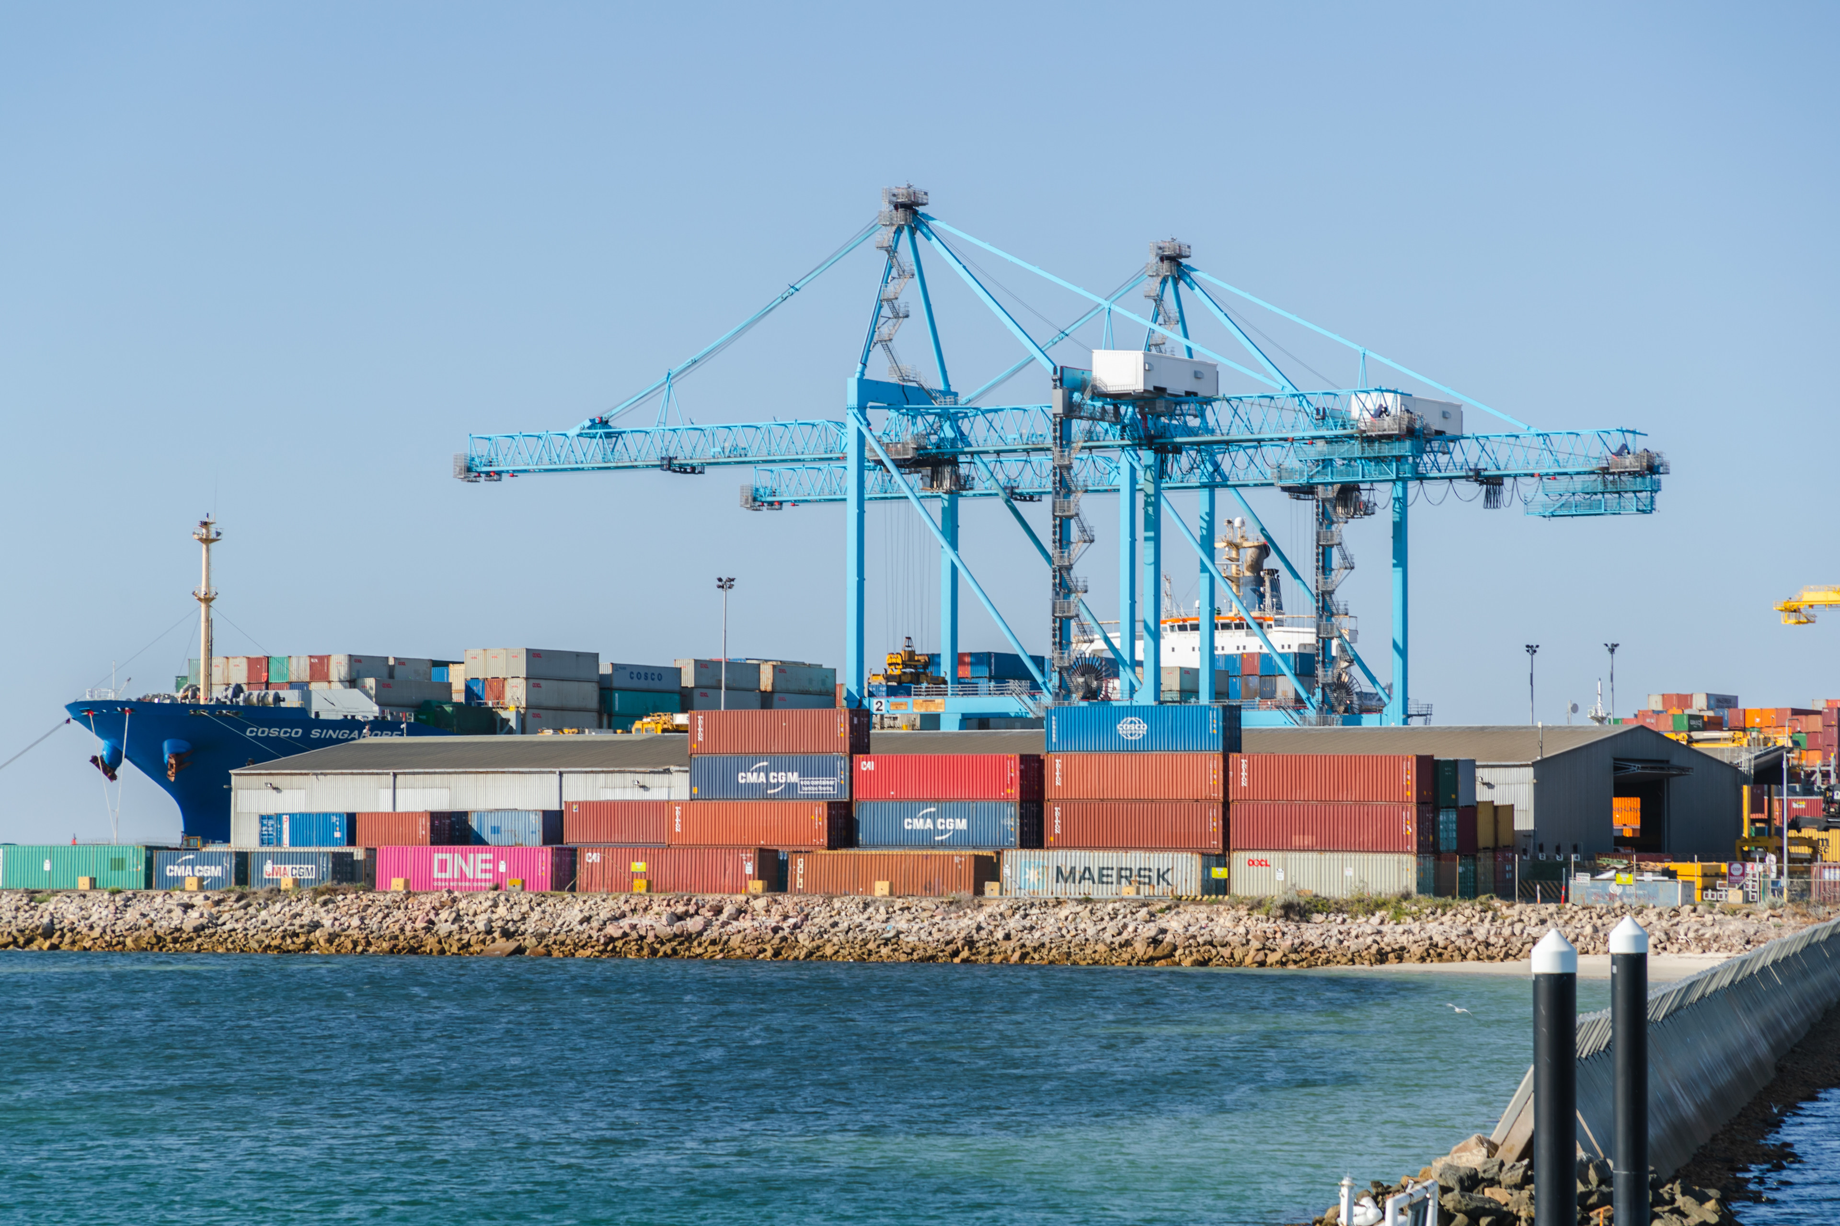
OFFICIAL
Home
Grounds for Refusal
In refusing a Temporary Licence, or a variation to a temporary licence, the Minister may have regard to the following.
The considerations outlined in section 34(2) of the Coastal Trading (Revitalising Australian Shipping) Act 2012
(if a notice in response is received) section 34(3) of the Coastal Trading (Revitalising Australian Shipping) Act 2012
Note that section 34(4) of the Coastal Trading (Revitalising Australian Shipping) Act 2012 requires any refusal to be made within 15 business days after the day the application is made.
Coastal Trading (Revitalising Australian Shipping) Act 2012
OFFICIAL

Slide 14



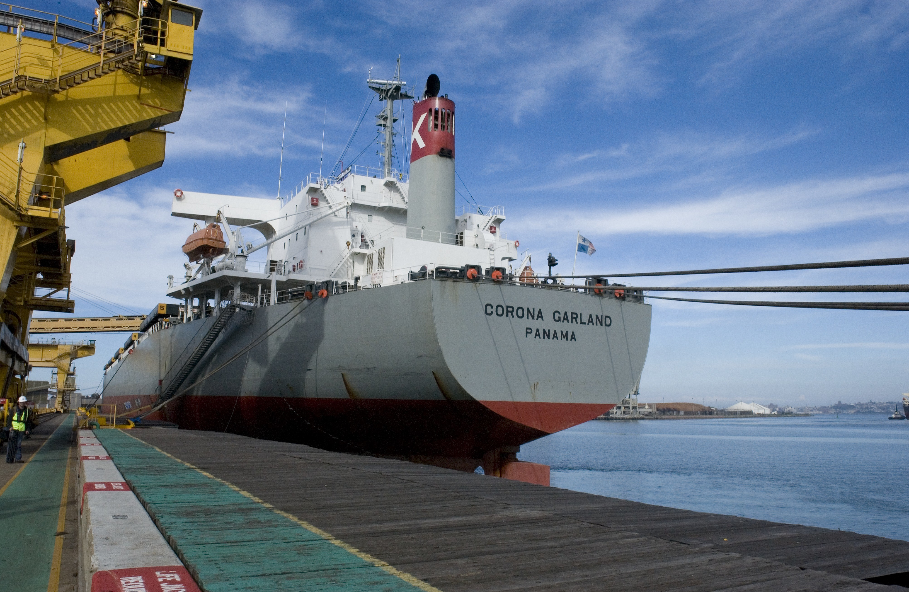
OFFICIAL
Home
Contact Us
The Department has a central contact point for mail and telephone communications.
The Shipping Business Unit is located at the Department’s Canberra Office.
+61 (2) 6136 8130
sbu@infrastructure.gov.au
Please note that the Department has a privacy policy
demonstrating its commitment to protecting personal privacy.
OFFICIAL

