Slide 1
Peri-Urban Mobile Program Round 2 Eligible Areas
The Peri-Urban eligible corridor surrounds the 19 Major Urban Centres (being the cities with population of 100,000 or more, based on the 2021 ABS Urban Centres and Localities dataset). The 19 are:
Adelaide, Ballarat, Bendigo, Brisbane, Cairns, Canberra/Queanbeyan, Central Coast, Darwin, Geelong, Gold Coast/Tweed Heads, Hobart, Melbourne, Newcastle, Perth, Sunshine Coast, Sydney, Toowoomba, Townsville and Wollongong.
The Peri-Urban eligible corridor encompasses:
The area 15km outside the Major Urban boundary;
The area 2km inside the Major Urban boundary; and
The major roads (based on the National Land Transport Network), to a length of 15km from the outside edge of the eligible corridor, and to a width of 5km either side of the road.

Slide 2
Modifications made to the Peri-Urban eligible corridors
Some small modifications to the Peri-Urban eligible corridor boundaries have been made to avoid leaving small pockets within the boundary, and also to adjust the overall shape of the Canberra Major Urban centre to avoid including the city centre in the definition (due to the long, thin nature of Canberra’s geography).
There are minor changes to the major city boundaries from Round 1 (Adelaide, Brisbane, Hobart, Melbourne, Perth and Sydney) due to moving to the 2021 ABS Urban Centres and Localities dataset from the 2016 dataset.
The nature of the Major Urban Centres along the coastline is that the coastal edge of these areas are mapped as an ‘edge’ to the boundary, despite typically not representing a peri-urban fringe area. It was therefore necessary to manually review and remove these sections while retaining any small portions that appeared to be peri-urban.

Slide 3
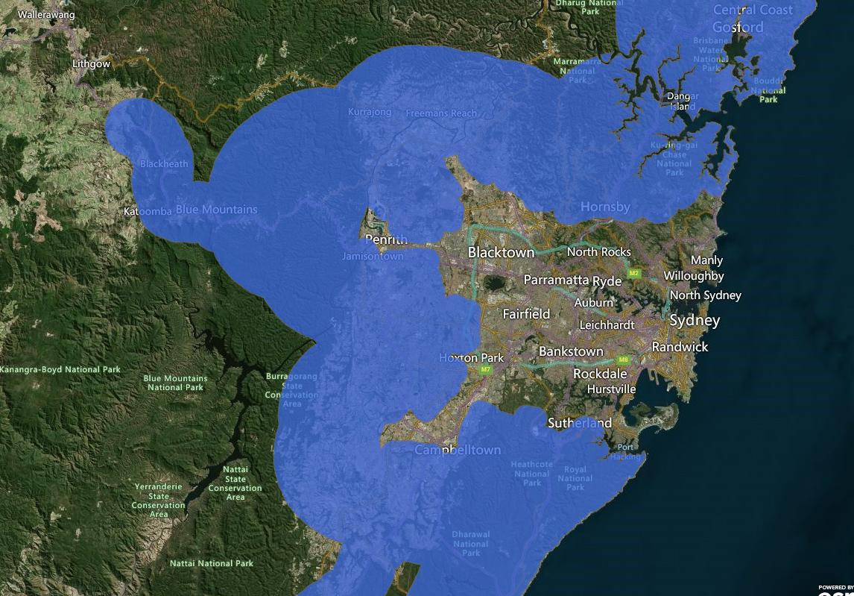
Sydney, NSW
Minor changes around the boundaries from Round 1 due to moving to the 2021 ABS Urban Centres and Localities dataset
Filled in the pocket left in the boundary around Winmalee, Mount Riverwood and Springview

Slide 4
Wollongong, NSW
Removed the edge of the coastal boundary around Wollongong CBD.

Slide 5
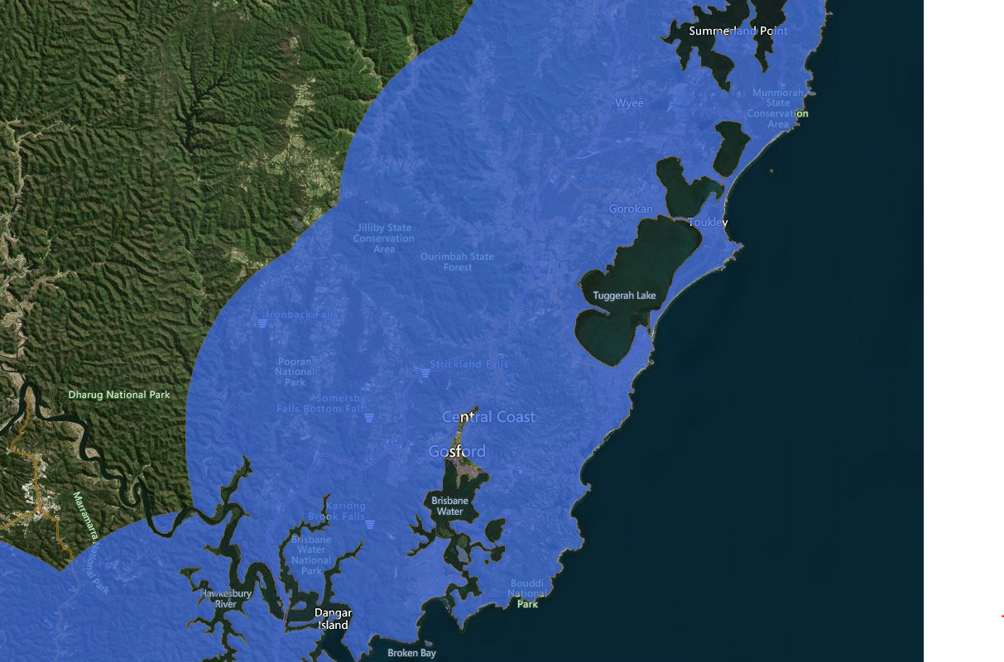
Central Coast, NSW
Removed the edge of the coastal boundary at Gosford CBD
Filled in the pocket at Picketts Valley

Slide 6
Newcastle, NSW
Removed the edge of the coastal boundary around Newcastle CBD and Port

Slide 7
Gold Coast / Tweed Heads, QLD
Removed the coastal edge in the Tweed Heads and Gold Coast CBDs
Removed the Pacific Highway extension south of Tweed Heads towards Byron Bay

Slide 8
Brisbane, QLD
Minor changes around the boundaries from Round 1 due to moving to the 2021 ABS Urban Centres and Localities dataset

Slide 9
Toowoomba, QLD
Extended the Warrego Highway length by around 5kms to cover the entire highway from Toowoomba to Brisbane

Slide 10
Sunshine Coast, QLD
Removed the coastal boundary at Maroochydore and Caloundra airport

Slide 11
Townsville, QLD
Removed the coastal boundary along the Townsville CBD

Slide 12
Cairns, QLD
Removed the coastal boundary along the Cairns CBD

Slide 13
Darwin, NT
Removed the coastal edge of the Darwin Major Urban Centre, including the Darwin Port

Slide 14
Perth, WA
Minor changes around the boundaries from Round 1 due to moving to the 2021 ABS Urban Centres and Localities dataset, including removing Rockingham and surrounding area.

Slide 15
Adelaide, SA
Minor changes around the boundaries from Round 1 due to moving to the 2021 ABS Urban Centres and Localities dataset

Slide 16
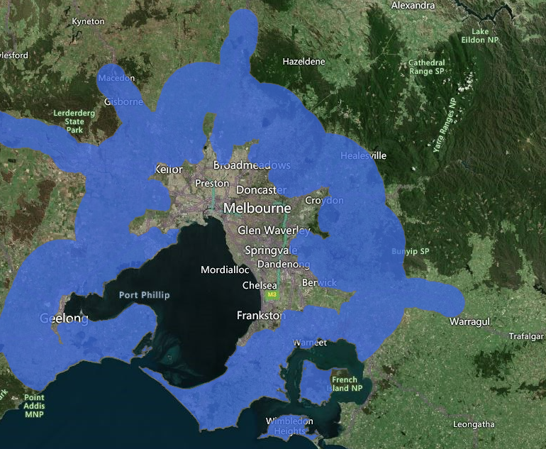
Melbourne, VIC
Minor changes around the boundaries from Round 1 due to moving to the 2021 ABS Urban Centres and Localities dataset

Slide 17
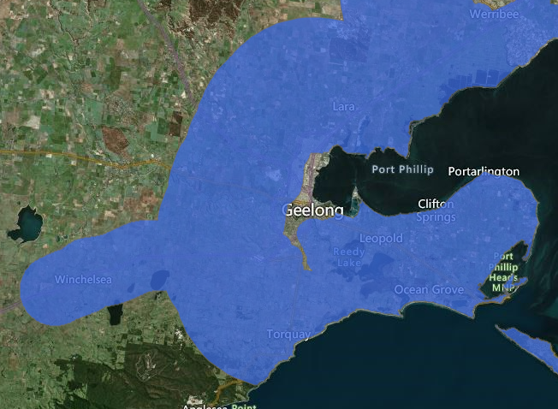
Geelong, VIC
Removed the coastal edge from the Geelong CBD and port.
Filled in the Portarlington and St Leonards peninsular.

Slide 18
Ballarat, VIC
No changes

Slide 19
Bendigo, VIC
No changes

Slide 20
Canberra / Queanbeyan, ACT
Adjusted the edge of the major urban boundary to the outside of the suburbs to the east and west of Canberra, so that the CBD and airport were not included in the peri-urban fringe. Removed the boundary between Canberra and Queanbeyan to create one shape

Slide 21
Hobart, TAS
Minor changes around the boundaries from Round 1 due to moving to the 2021 ABS Urban Centres and Localities dataset, including removing the coastal boundary around Battery Point, Bellerive, Hobart and Glenorchy.

