Slide 1

On Farm Connectivity Program
Eligible Equipment Catalogue

Slide 2
On Farm Connectivity Program
Eligible Equipment valued at $16,000 supplied by Eligible Equipment Supplier
Primary Producer pays 50% or $8,000
Eligible Equipment Supplier claims a rebate of 50% or $8,000
The Australian Government’s On Farm Connectivity Program is providing $30 million over 2 years to enable primary producers in agriculture, forestry and/or fisheries to take advantage of connected machinery and sensor technology.
The Program will provide a rebate of 50 per cent of the cost of Eligible Equipment, including installation and training, of between $3,000 and $30,000 (GST exclusive). The rebate will be paid to the Eligible Equipment Supplier, with the Primary Producer purchasing the equipment, and paying the balance of the cost after the rebate to the Eligible Equipment Supplier

Slide 3
Eligible Equipment Catalogue
This document provides an overview of the types of Internet of Things (IoT) technology and devices eligible for a rebate from the On Farm Connectivity Program.
This catalogue is not prescriptive and is intended as a guide to help you understand the kinds of technology and products eligible for the rebate.
We encourage you to access connectivity literacy resources and consult with experts to ensure any equipment you are considering will meet your needs and represent an informed investment.

Slide 4
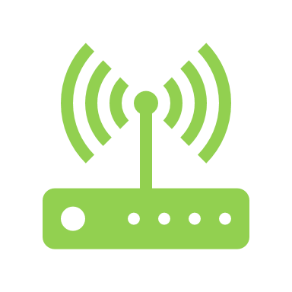
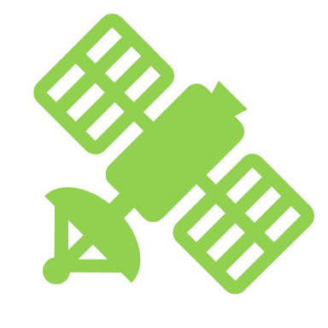
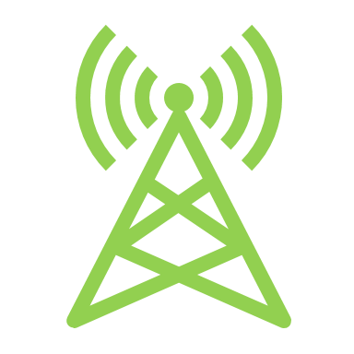

Connectivity solutions in scope
LPWAN
Satellite
Cellular
Wi-Fi
On-farm connectivity solutions facilitate communication between IoT devices that support agricultural activities and the internet. There are four broad categories of eligible connectivity solutions that support an integrated farm-wide agtech network:
Low Power Wide Area Networks (LPWAN)
Cellular
Satellite
Wi-Fi.
All equipment using these connectivity solutions, and enable and extend connectivity across a primary production enterprise are eligible through the Program. Primary producers should consider which solution best meets their needs.

Slide 5

LPWAN
There are several different technologies that sit within the LPWAN category.
LoRaWAN: LoRaWAN uses long range radio communication or ‘LoRa.’ LoRa allows devices to communicate up to several kilometres while consuming very little power. LoRaWAN, can operate in the absence of any cellular coverage.
NarrowBand-IoT (NB-IoT): NB-IoT transmits data over cellular networks, providing low power and low bandwidth connectivity to IoT devices. NB-IoT can provide better coverage at lower power levels than traditional cellular technologies, which can make it more suitable for rural areas.
SigFox: This technology can transmit small amounts of data over long distances. It is a low power and low cost model, but may not be suitable for applications that require high data rates or frequent data transmission.
CAT-M1: Cat M1 is a type of Long-Term Evolution (LTE) cellular technology uses licensed narrowband for IoT devices that require high data rates and low power consumption and latency, such as asset tracking.
LTE-M: LTE-M is an LTE cellular technology for low-power IoT devices. LTE-M is optimised for IoT devices that require low data rates and a long battery life, such as remote sensors, utility meters, and healthcare devices.
LPWAN (Low Power Wide Area Network) is a broad category of wireless communication technologies that support IoT devices requiring low power consumption and provide long-range connectivity.

Slide 6
Connectivity equipment
Antennas, beacons and radio transmitters: Devices that transmit or receive radio signals. For connected agtech, they capture and transmit data from sensors and other IoT devices, to gateways and routers. Beacons are usually smaller wireless devices that transmit signals to nearby devices. In the context of agtech, they are mainly used for location-based services, such as asset tracking.
Boosters and repeaters: Boosters increase the strength of a wireless signal and are commonly used in areas with poor cellular or wireless coverage to improve signal strength and connectivity. Repeaters extend the range of a wireless signal.
Gateways and routers: A gateway serves as a single access point and converter IoT devices to external networks. For agtech, they can bring together data for analysis and visualisation. A router receives the internet connection and distributes it to computers and devices.
Portable hotspots: A portable hotspot is vehicle-mounted antennae that provides reliable on-the-move connectivity for primary producers. In agtech, they can support fieldwork in remote locations where internet access may not be available.
Products that provide connectivity between IoT devices and a local area network (LAN) or wide area network (WAN).

Slide 7
Environment monitoring
Soil moisture probes: These sensors measure moisture in the soil and can be connected to a wireless network to provide data on soil moisture levels.
Microclimate monitors: Devices that measure parameters such as leaf wetness, frost, rainfall and wind speed in specific areas, crop fields or greenhouses.
Weather monitors: Devices that measure and record weather parameters, such as temperature, humidity, wind speed and direction, and rainfall.
Plant growth monitors: Devices that monitor parameters that affect the growth of plants and fruit, including stem and fruit diameter using precision sensors called dendrometers.
Water quality monitors: Devices that measure parameters of water quality, such as pH, dissolved oxygen, and turbidity, and can be used to monitor the quality of irrigation water.
Water flow and pressure monitors: Devices that monitor the flow rate and pressure of water in irrigation systems, supporting irrigation schedules and even distribution of water.
These devices provide environmental data to farmers and growers that can be analysed and used to make informed decisions that could optimize growing conditions, harvesting time and improve overall crop yields.
This equipment can be connected to a wireless network. Some products may need to be physically paired with other products to provide wireless functionality.

Slide 8
Farm management
Cameras: Used for surveillance and monitoring farm activities, livestock, and equipment. They can be connected to a network to provide remote viewing and analysis.
Asset trackers: Devices that track the location and movement of farm assets such as vehicles, equipment and livestock. These devices can be connected to a network for real-time tracking and management.
Battery monitors: Devices that monitor battery levels and power consumption of farm equipment and vehicles.
Staff safety monitors: Devices that monitor the safety of farm staff, particularly in hazardous areas or situations. These devices can detect falls, injuries, and other incidents and alert relevant personnel.
Fence monitors: Devices that monitor the condition and status of electric and other types of fences and alert farmers to breaches or damage.
Silo and storage monitors: Devices that monitor the level and condition of grain and other agricultural products stored in silos and other storage facilities. They can detect moisture, temperature and pest infestations, allowing for timely intervention.
Fuel level monitors: Devices that monitor the fuel levels of farm vehicles and equipment, allowing for active management.
Livestock monitoring systems: Systems that track the location and health of livestock. These systems may include GPS tracking, activity monitors and health sensors.
Farm management systems assist with monitoring on-farm conditions, infrastructure, livestock, assets and safety, and can provide timely alerts if certain thresholds are met. Many devices can be connected to a network for real time monitoring.

Slide 9
Remote automation and control
Valve and irrigation controllers: Devices that control the flow of water through irrigation systems. They can be programmed to open and close valves at specific times and in specific amounts, allowing for precise control of water usage.
Pump controllers: Devices that regulate the operation of pumps. These devices are commonly used to move water or other liquids through irrigation systems or other agricultural equipment. They can be programmed to turn pumps on and off at specific times, or to maintain a certain pressure or flow rate.
Aeration controllers: Devices that regulate the amount of oxygen and carbon dioxide in a greenhouse or other enclosed growing environment. They can be used to adjust ventilation systems, fans, or other equipment to maintain optimal growing conditions for plants.
These devices provide primary producers with tools to enable remote automation and control of connected assets.

Slide 10
Information dashboards and network software
Holistic Connectivity Solution Diagram
IoT devices
Data is generated by a network of IoT sensors and monitoring equipment
Dashboards are information systems that bring together and display data from IoT devices to support decision-making
While Dashboards are not always necessary to access data outputs from IoT networks, access to data analysis tools may be necessary for some connectivity solutions.
Connectivity network
Data is transferred to the internet or cloud by a network of gateways and nodes
Data platforms
Software platforms host and collate data
The Program will fund subscriptions for data aggregation platforms and software that accompany the purchase of eligible hardware up to a cap of 10% of the total purchase price. Homestead and business internet costs are not eligible for funding.
Dashboards
Allow data to be visualised and analysed

