Slide 1

Vehicle Safety Standards
2017-18 Annual Stakeholder Survey
November 2018

Slide 2
Summary
Introduction
The Motor Vehicle Standards Act 1989 (the MVSA) regulates the safety, environmental and anti-theft performance of all vehicles entering the Australian market for the first time—both new and used.
Vehicle Safety Standards Branch (VSS) within the Department of Infrastructure, Regional Development and Cities (the department) is responsible for administering the MVSA and its associated regulations, and developing and implementing safety standards and reforms.
Under the Australian Government’s Regulator Performance Framework the department assesses its performance as a regulator in relation to the MVSA each year.
To inform this assessment for 2017-18, the department undertook an external stakeholder survey in August/September 2018.
The stakeholder survey provided the department with the opportunity to capture the views of external stakeholders on the department’s regulatory performance over 2017-18 and identify opportunities for improvement.
Survey approach
The stakeholder survey was emailed to all entities the department has had a regulatory interaction with (where there was an email address available). Approximately 7,605 emails were sent out.
The survey was also promoted on the department, Road Vehicle Certification System and Registered Automotive Workshop Scheme websites – and through the Road Vehicle Compliance Update.
The survey was open for one month.
537 responses were received in total.
Survey responses were anonymous.
Table Notes
*Importers for the purposes of this summary table includes both 'regular importers' and respondents who interacted with the department as an individual (primarily personal importers)
^Survey respondents who identified as ‘Other’ (22 responses) have been excluded for the purposes of this summary table

Slide 3
Summary
Survey results
There was a very low response rate (5% of the total population) and a high proportion of responses were from individuals (45% of total responses). As such, survey results should be interpreted with caution. However, in comparing the survey results for this year against previous years, the department has identified a number of areas of improved performance, and areas where further improvement is still required.
Areas of improved performance
Fair and consistent decision making
Timeliness of application assessment
Timely and helpful responses to queries
Areas where improvement is required
Contacting stakeholders about changes to policies, processes that affect them
Accepting suggestions and feedback
Reasons for negative decisions are clearly explained
The department is currently considering the survey results in further detail, as well as the comments survey respondents provided, to identify specific actions to address these and other areas for improvement.

Slide 4
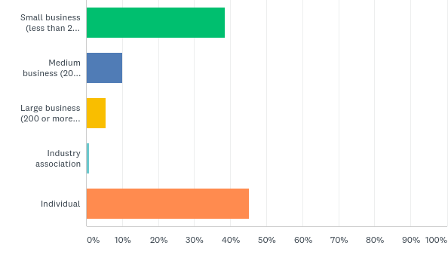
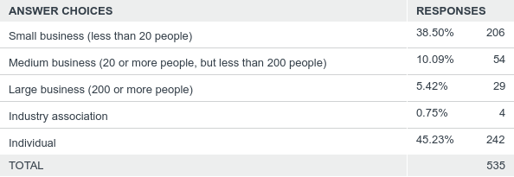
Q1: What type of entity are you?
Answered: 535 Skipped: 2
84% of respondents were individuals or worked in small businesses

Slide 5
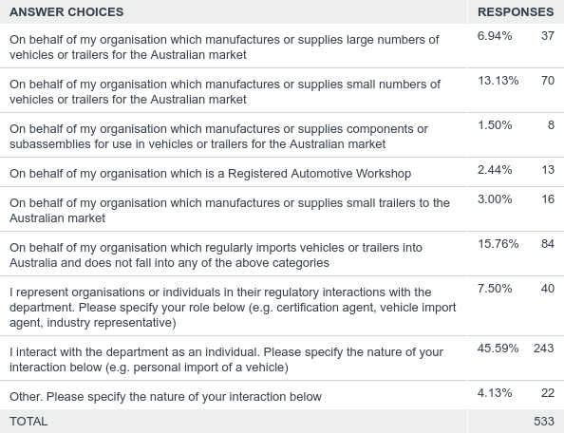
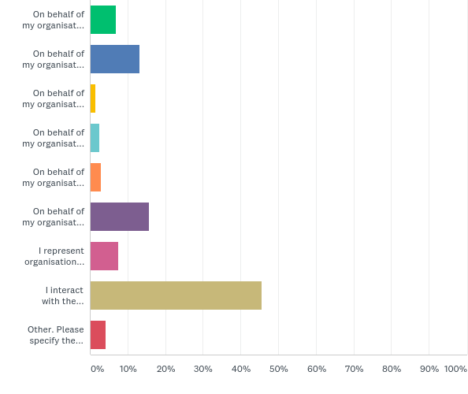
Q2: Which one of the following best describes how you typically interact with the department?
Answered: 533 Skipped: 4
46% of all respondents indicated that they interacted with the department as an individual. In most instances, these interactions related to the personal import of a vehicle

Slide 6
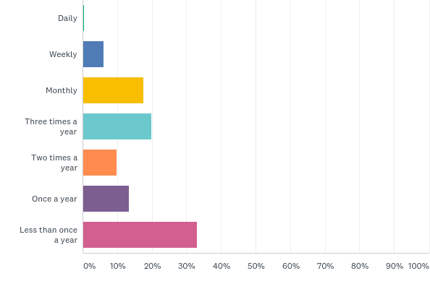
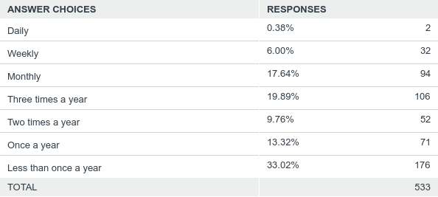
Q3: On average, how often would you contact, or be contacted by the department about regulatory matters?
Answered: 533 Skipped: 4
33% of respondents interacted with the department less than once a year - reflecting the high number of personal importers responding to the survey

Slide 7
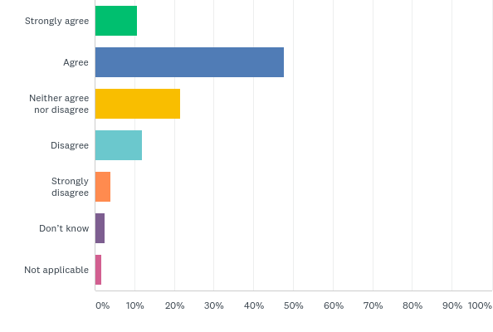
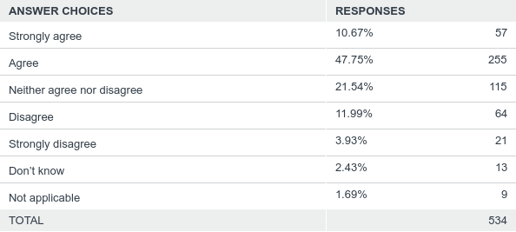
Q4: I can easily find the information I am looking for on the department’s website
Answered: 534 Skipped: 3
58% of respondents agreed or strongly agreed that information is easy to find on the department’s website

Slide 8
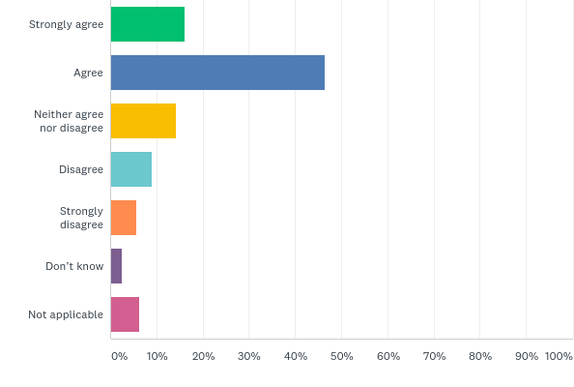
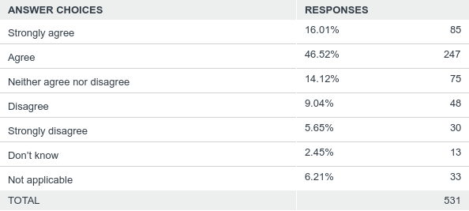
Q5: When I contact the department with a query, they answer it quickly and with the information I need
Answered: 531 Skipped: 6
63% of respondents agreed or strongly agreed that the department answers queries quickly and with the information needed

Slide 9
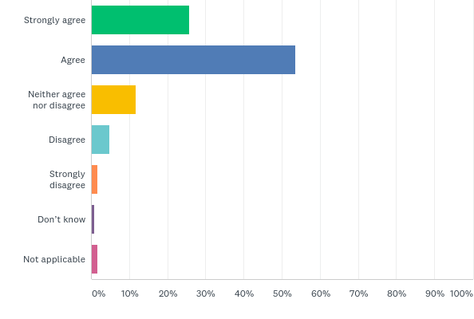
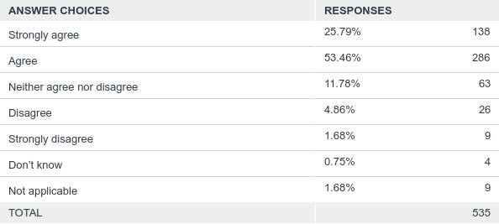
Q6: I understand the rules I need to follow to submit an application to the department or to seek approval from the department
Answered: 535 Skipped: 2
79% of respondents agreed or strongly agreed with the statement that they understand the rules they need to follow to submit an application or seek an approval

Slide 10
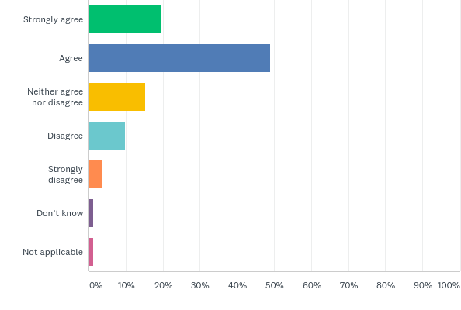
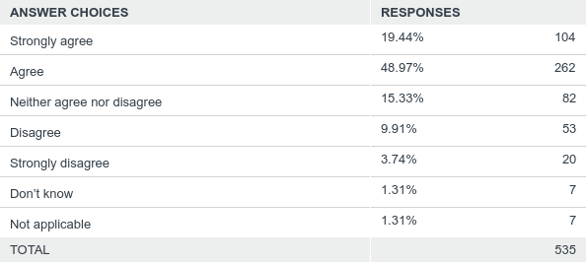
Q7: I find it easy to follow the process for submitting an application to the department or requesting an approval from the department
Answered: 535 Skipped: 2
68% of respondents agreed or strongly agreed that the process for submitting an application or requesting an approval is easy to follow

Slide 11
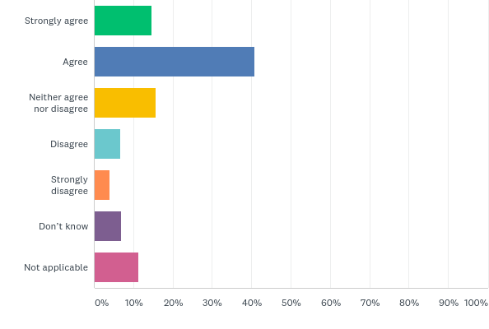
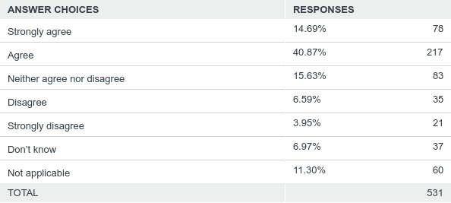
Q8: If I am advised that I have made an error, or that I have not provided enough evidence for my application, the department provides me with sufficient information to enable me to fix the issue
Answered: 531 Skipped: 6
56% of respondents agreed or strongly agreed that the department provides them with sufficient information to fix an issue relating to their application

Slide 12
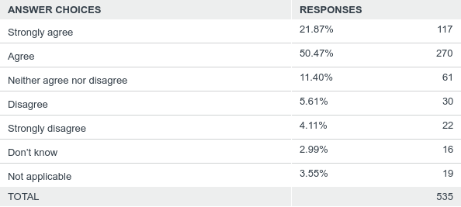
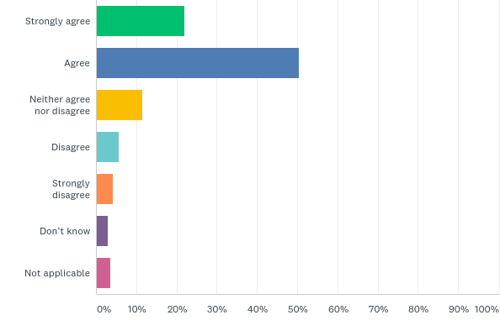
Q9: Once I have given the department all the information it needs, my application is processed within the timeframe specified on the department’s website
Answered: 535 Skipped: 2
72% of respondents agreed or strongly agreed that their application is processed within the timeframe specified on the department’s website

Slide 13
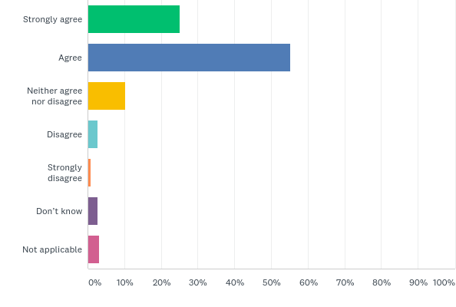

Q10: Once my application is approved, I understand my ongoing obligations in order to keep the approval I have been granted
Answered: 535 Skipped: 2
80% of respondents agreed or strongly agreed with the statement that they understand their ongoing obligations once an approval has been granted

Slide 14
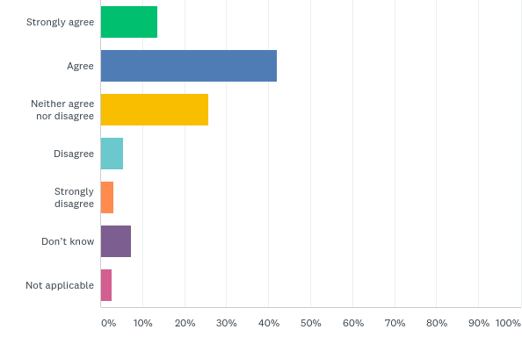

Q11: Decisions the department makes are fair and consistent
Answered: 533 Skipped: 4
56% of respondents agreed or strongly agreed that the decisions the department makes are fair and consistent
26% of respondents were neutral (neither agreed nor disagreed)

Slide 15
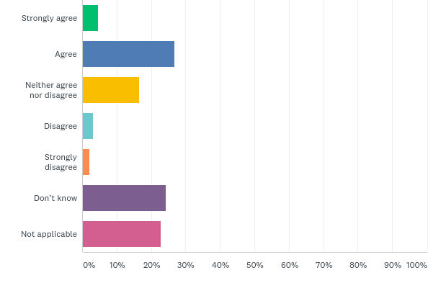

Q12: If the department makes a negative decision (such as refusing to grant an approval) it clearly explains the reasons for the decision
Answered: 533 Skipped: 4
31% of respondents agreed or strongly agreed that the department clearly explains the reasons for a negative decision
47% indicated they did not know or that the question was not applicable

Slide 16
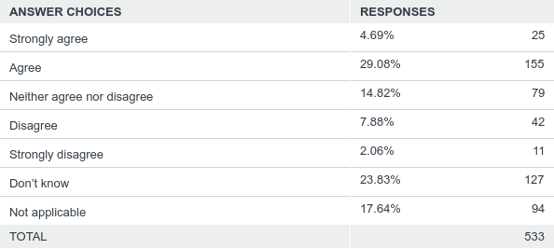
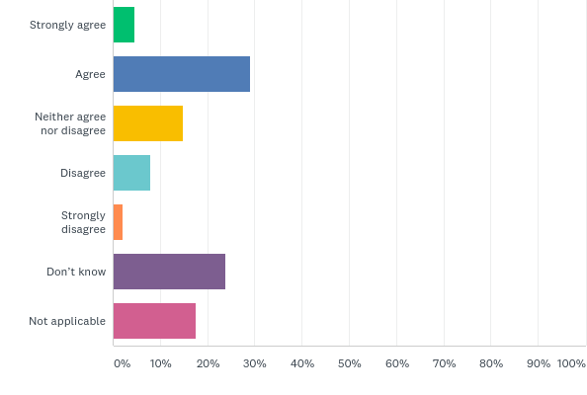
Q13: If I do not agree with the department’s decision, I am aware of, and know how to have the decision reviewed
Answered: 533 Skipped: 4
34% of respondents agreed or strongly agreed that they were aware of and know how to have a decision reviewed if they did not agree with it
41% indicated they did not know or that the question was not applicable

Slide 17
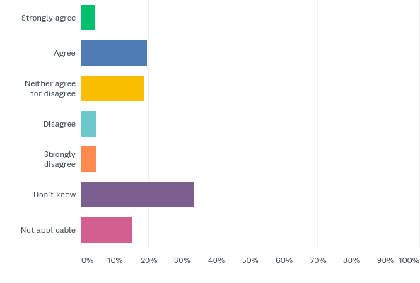
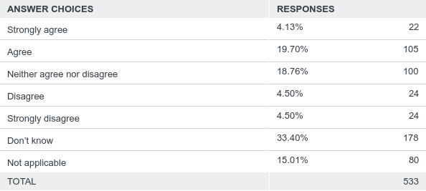
Q14: The department does a good job of handling complaints about its service
Answered: 533 Skipped: 4
24% of respondents agreed or strongly agreed that the department does a good job of handling complaints – 19% were neutral
48% indicated they did not know or that the question was not applicable

Slide 18
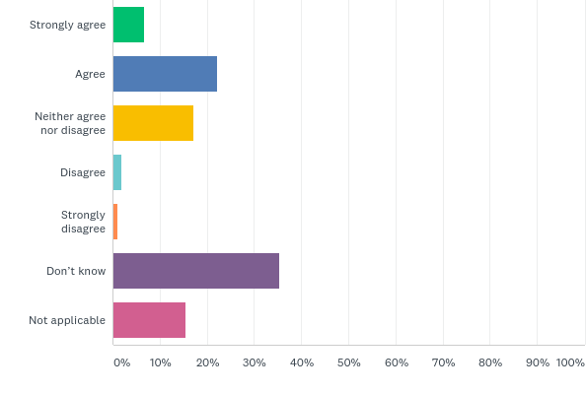

Q15: Audits, inspections or investigations carried out by the department are conducted professionally and fairly
Answered: 533 Skipped: 4
29% of respondents agreed or strongly agreed that audits, inspections and investigations carried out by the department are conducted fairly and professionally
51% indicated they did not know or that the question was not applicable

Slide 19
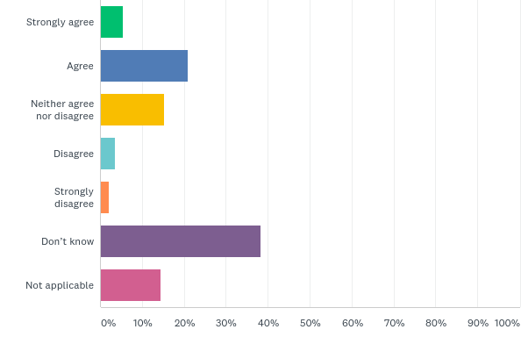
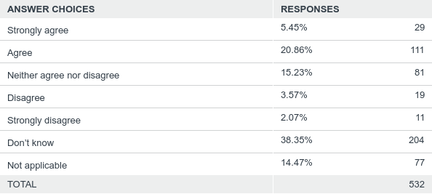
Q16: The department takes appropriate action when it is told about safety issues or if rules have been broken
Answered: 532 Skipped: 5
26% of respondents agreed or strongly agreed that the department takes appropriate action when it is told about safety issues or non-compliance
53% indicated they did not know or that the question was not applicable

Slide 20
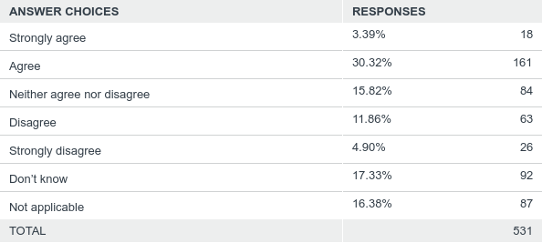
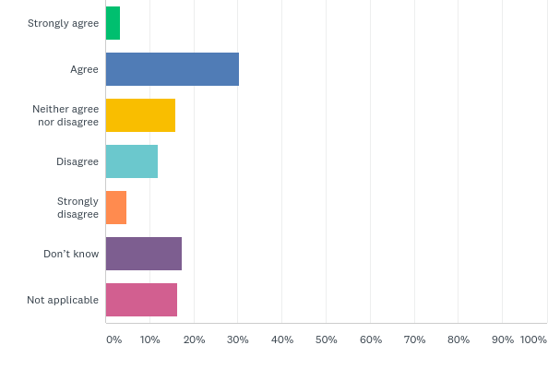
Q17: I am contacted by the department about changes that are made to the rules, policies or processes that affect me
Answered: 531 Skipped: 6
34% of respondents agreed or strongly agreed that the department contacted them about changes that affect them - 17% disagreed or strongly disagreed
34% indicated they did not know or that the question was not applicable

Slide 21
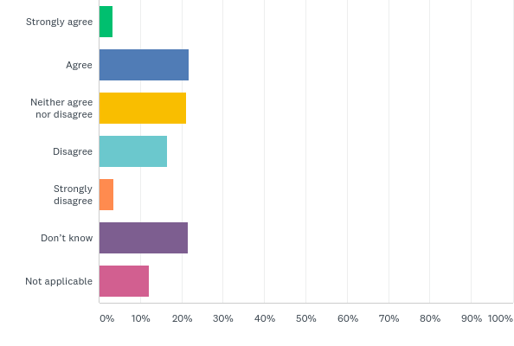
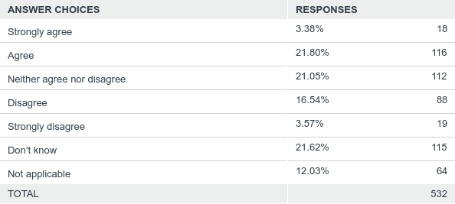
Q18: I know how to give the department suggestions for how it can improve the way it does business
Answered: 532 Skipped: 5
25% of respondents agreed or strongly agreed that they knew how to give the department suggestions on how it can improve - 20% disagreed or strongly disagreed
34% indicated they did not know or that the question was not applicable

Slide 22
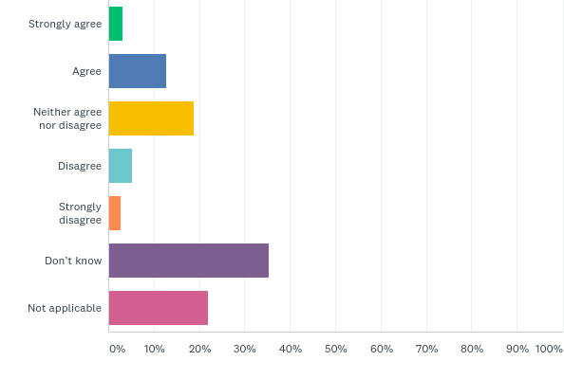

Q19: Any suggestions I provide to the department are given genuine consideration
Answered: 532 Skipped: 5
16% of respondents agreed or strongly agreed that the department gives genuine consideration to suggestions they make - 19% were neutral
57% indicated they did not know or that the question was not applicable

Slide 23
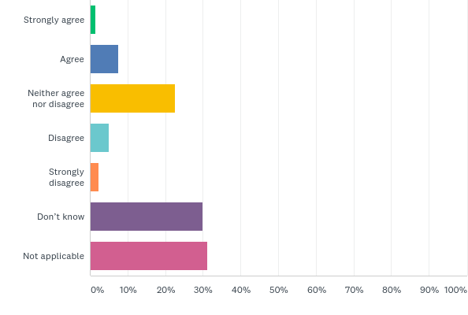
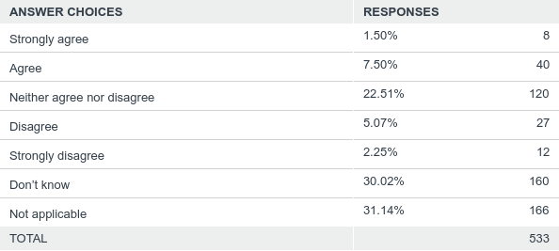
Q20: The department tells me about the changes it has made as a result of my suggestions
Answered: 533 Skipped: 4
23% respondents were neutral regarding the statement that the department advises them of changes made as a result of their suggestions
61% indicated they did not know or that the question was not applicable

Slide 24
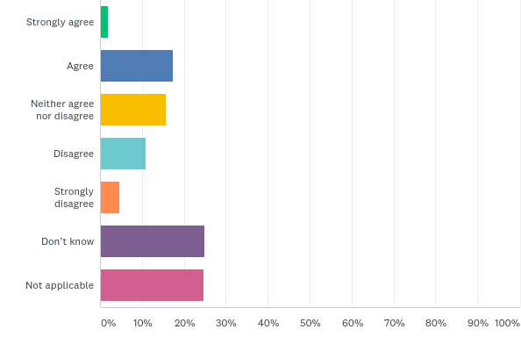

Q21: The department understands my operating environment and the current and emerging issues that affect my business
Answered: 530 Skipped: 7
19% of respondents agreed or strongly agreed that the department understands their operating environment and issues that affect their business - 15% disagreed or strongly disagreed
50% indicated they did not know or that the question was not applicable

Slide 25
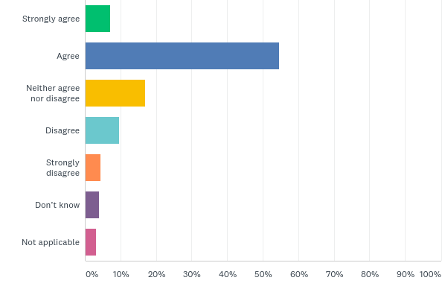
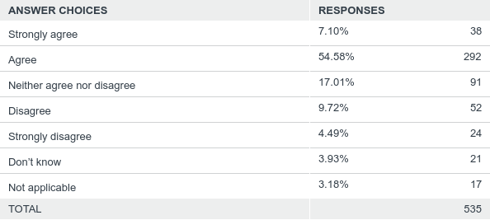
Q22: The amount of paperwork or administrative processes I have to complete is appropriate
Answered: 535 Skipped: 2
62% of respondents agreed or strongly agreed that the amount of paperwork or administrative processes was appropriate

